Slide 1
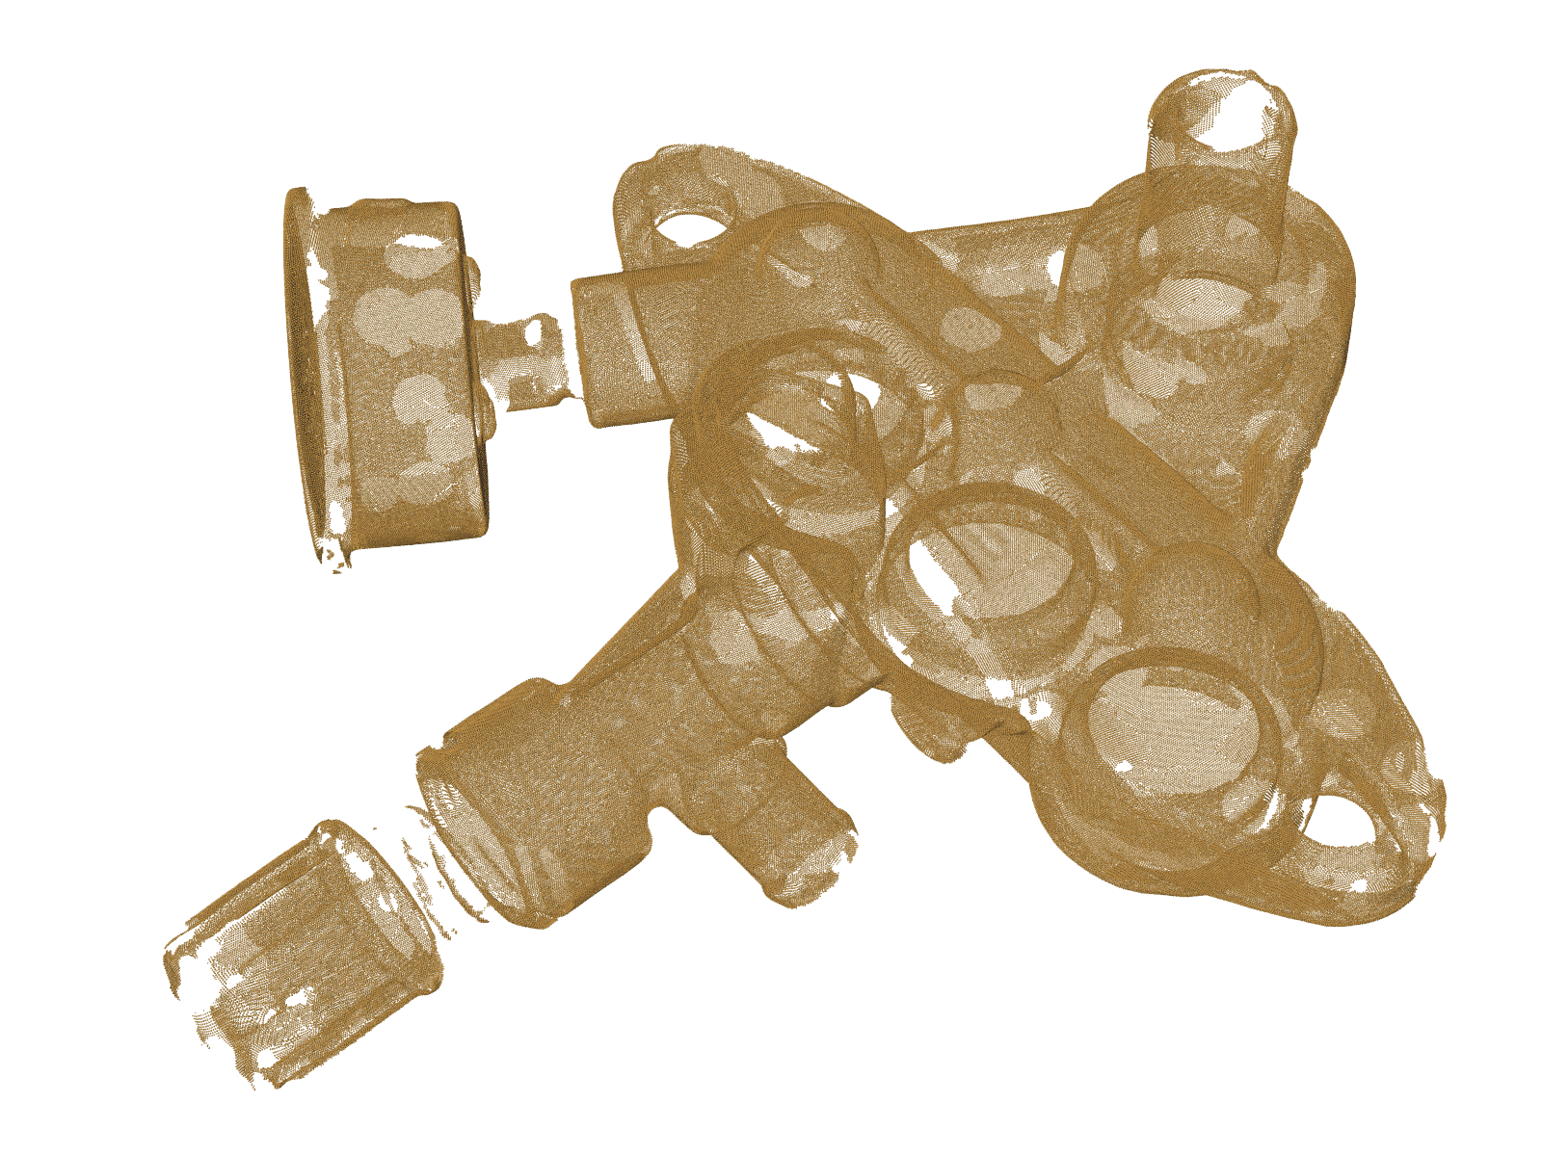
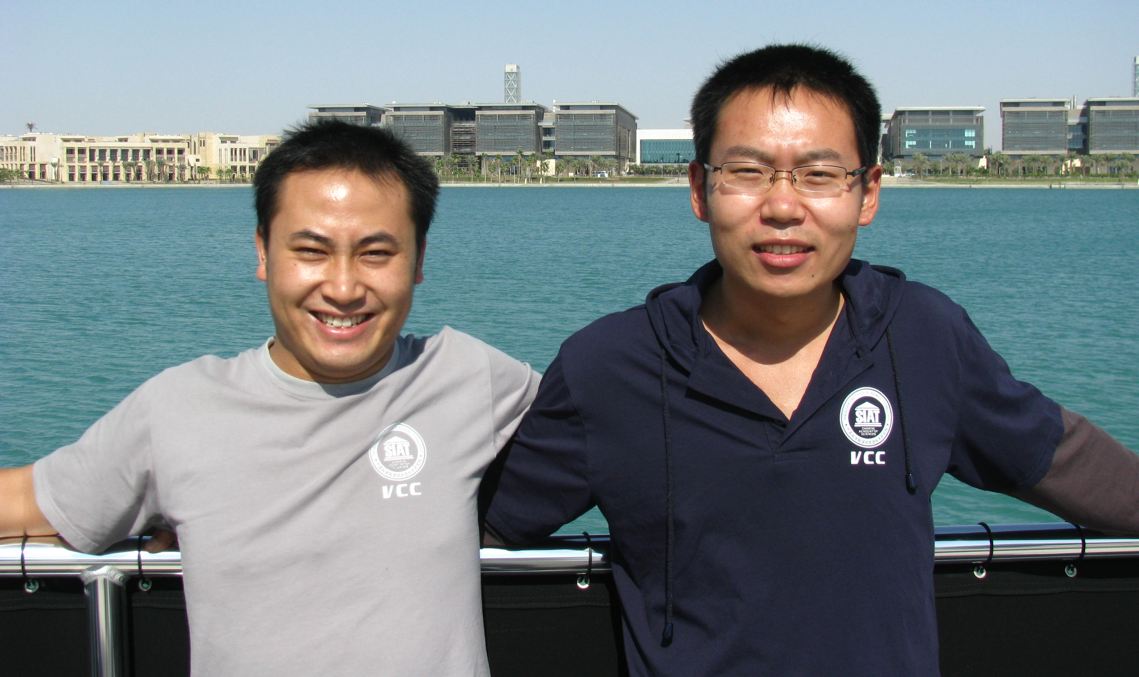






GlobFit: Consistently Fitting Primitives by
Discovering Global Relations
Yangyan Li
X. Wu
Y. Chrysanthou
A. Sharf
D. Cohen-Or
Niloy Mitra
Notes:
Thank you and Good morning everyone!
Today, we are going to introduce GlobFit – a framework that allows simultaneous recovery of primitive parts and their mutual relations.

Slide 2
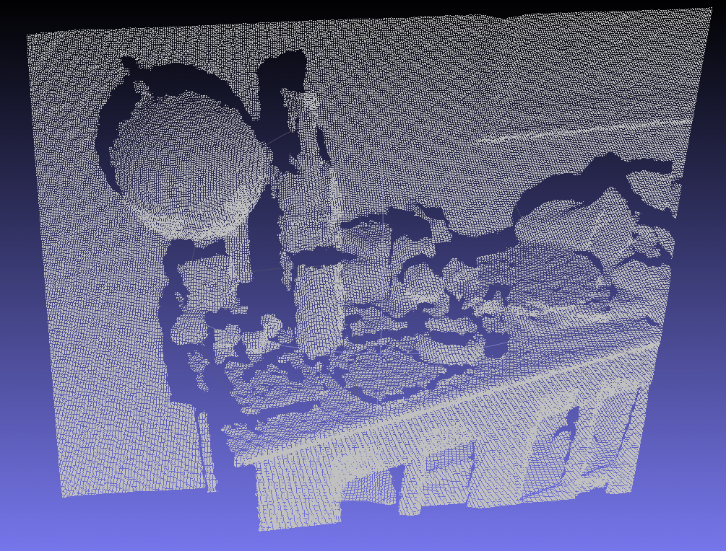
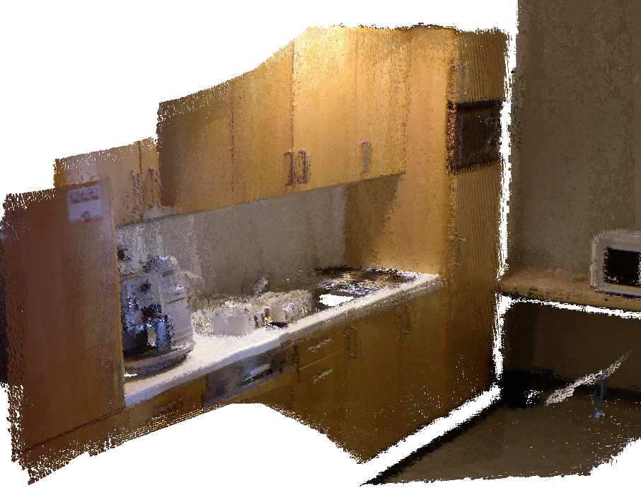
New hardware, New possibilities
Notes:
Surface reconstruction has a long history in computer graphics and in reverse engineering.
Our goal is bit different. We perform reconstruction as well as shape/scene understanding – topics, traditionally considered separately.
There is a renewed interest given the growing popularity of 3D acquisition hardware …. We observe a trend towards faster acquisition but poor data quality; In such a setting priors become important ..
We learn priors from the data .. Simultaneously …
We observe that scenes are often dominated by man-made objects. Such objects have large number of relations across its parts.
There are inherent ambiguity in which relations are correct and which spurious; Like in life, we want to commit to the correct ones.
Interesting balance between data and confidence in relations;

Slide 3
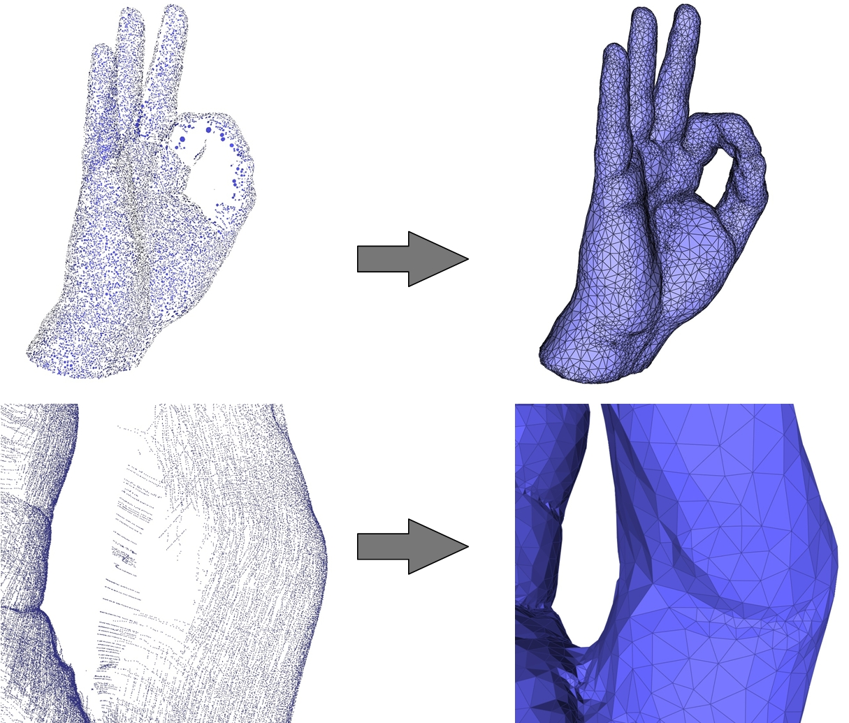
Surface Reconstruction
Notes:
Surface Reconstruction from point cloud is a difficult and ill-posed problem.
Traditionally smooth surfaces are preferred.

Slide 4
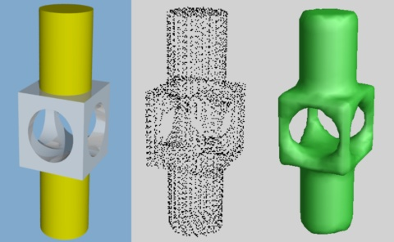
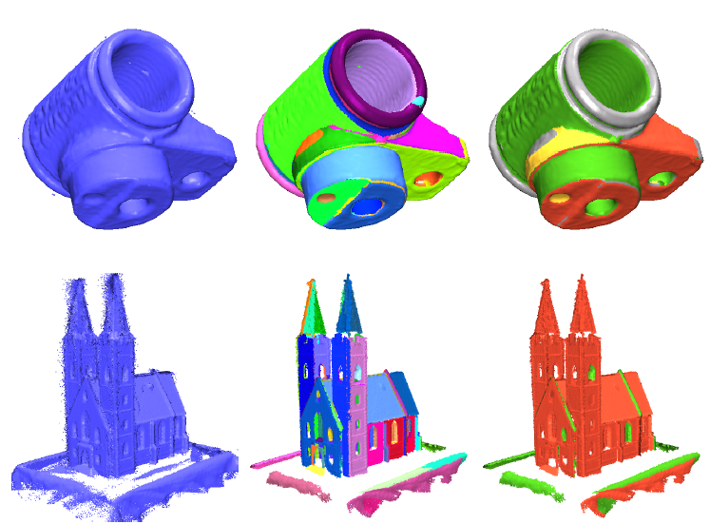
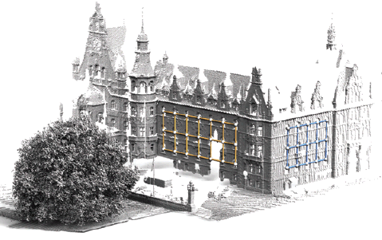
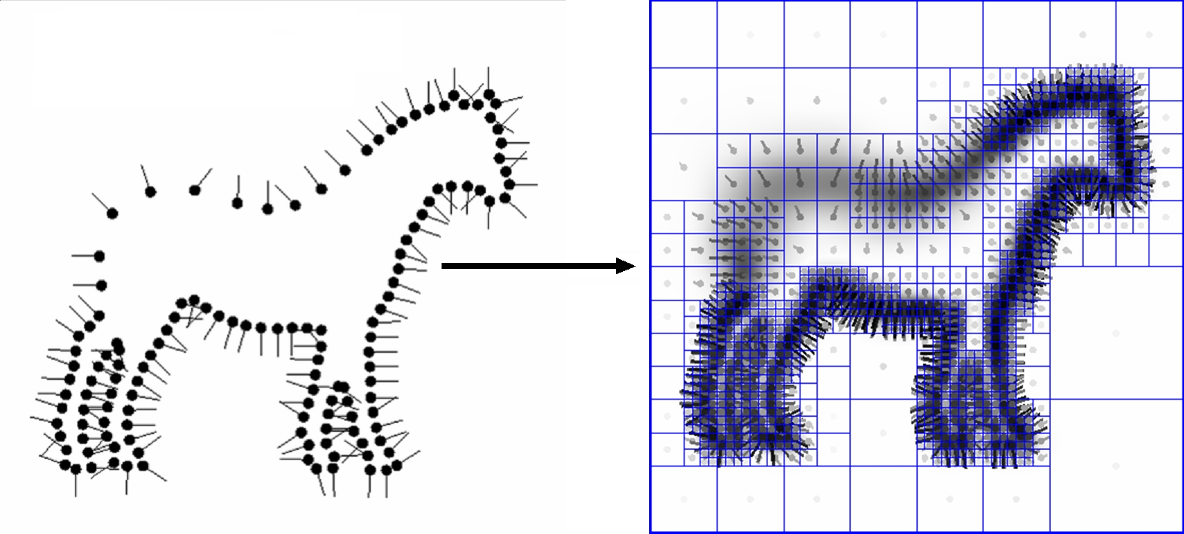
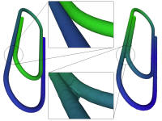
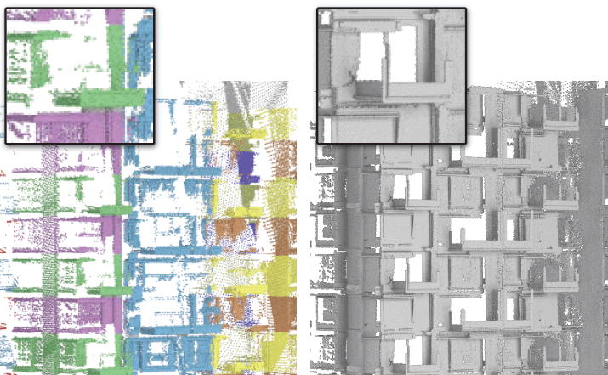
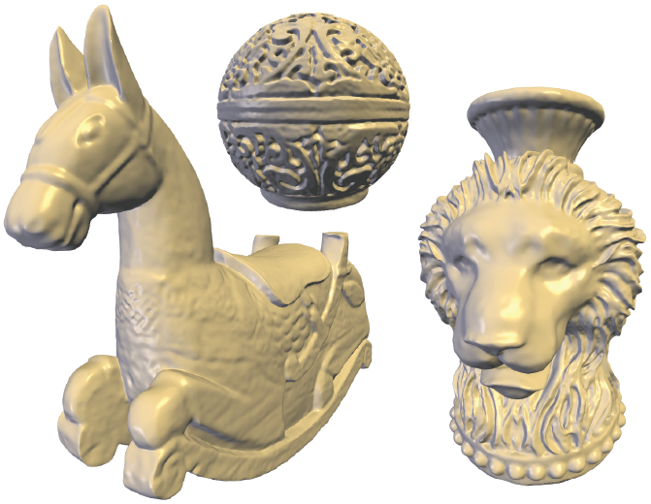
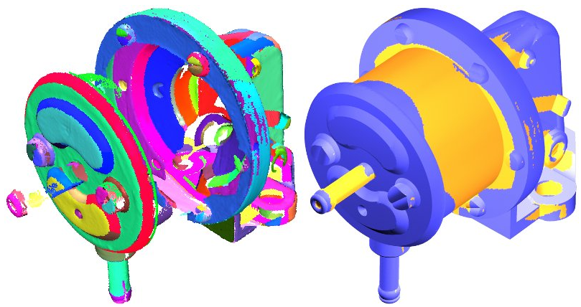
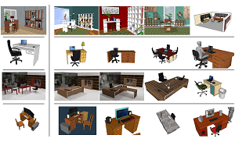
Related Work
[Hoppe et al. 1992]
[Schnabel et al. 2007]
[Pauly et al. 2008]
[Khazdan et al. 2006]
[Gal et al. 2007]
[Zheng et al. 2010]
[Oztireli et al. 2009]
[Schnabel et al. 2009]
[Fischer et al. 2011]
Notes:
Classical topic in reverse engineering.
1) Talk about gal et al., refer to other methods in the session, etc. 2) talk about regularity detection and symmetrization, 3) early works in vision and reverse engineering
Surface Reconstruction from point cloud is a difficult and ill-posed problem, which has long history in computer graphics.
Smoothness prior is widely used to regularize the solution by favoring smooth reconstructions.
Alternate strategies have been proposed to recover sharp features.
Surface reconstruction involving local fitting of primitive structures has long been the standard in reverse engineering and also in the graphics community.
However, all of them only make use of local priors. In contrast, we take a global approach which accounts for the inter-primitive relations, both local and global.

Slide 5

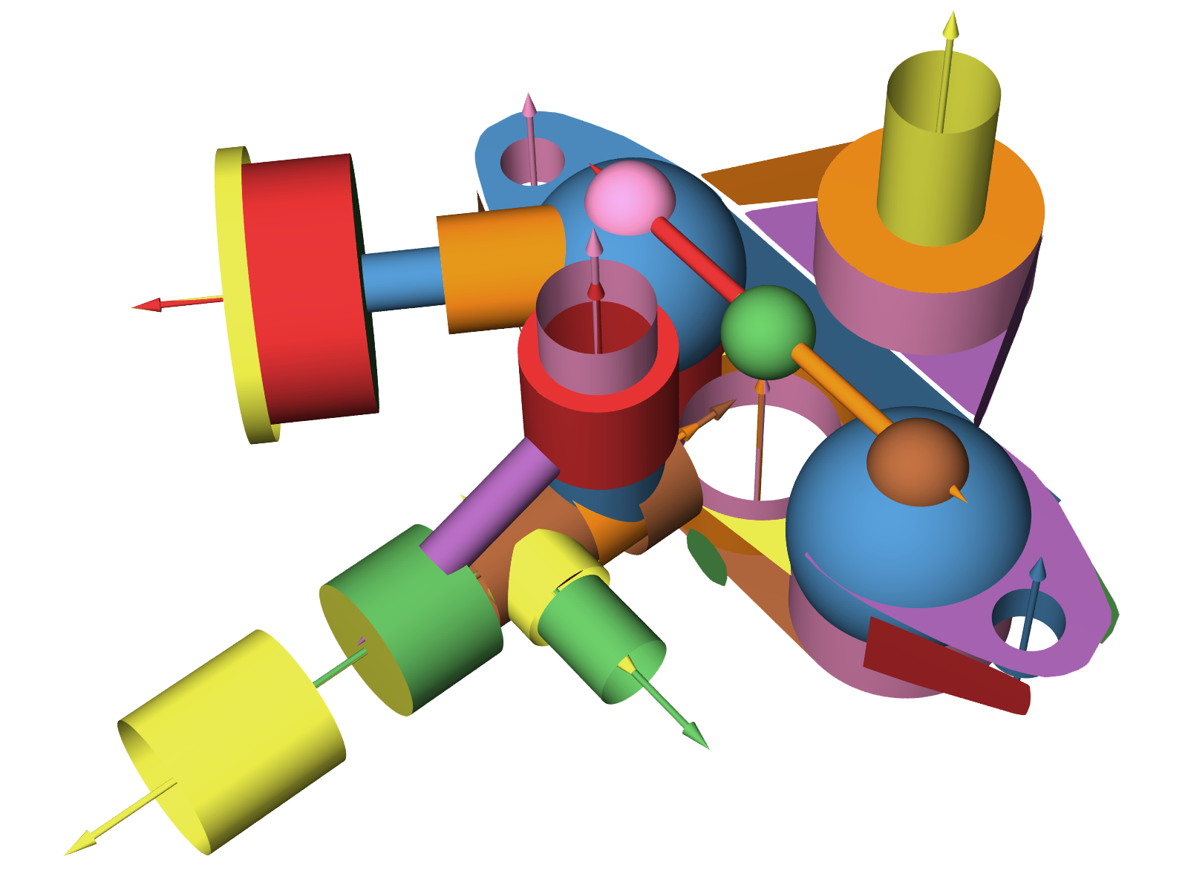
New Challenges
surface reconstruction
+
structural
insights
point cloud
Notes:
Beyond surface reconstruction, we have primitives and their global mutual relations reconstructed. The reconstructed structural insights can be directly feed to intuitive editing systems such as iWires, and can be to build semantic searching systems.
Or searching, as in Fischer paper.
Regularity is not by chance, but relates to manufacturing .. Etc.

Slide 6
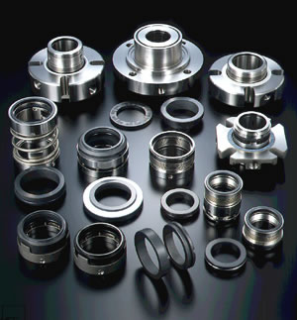
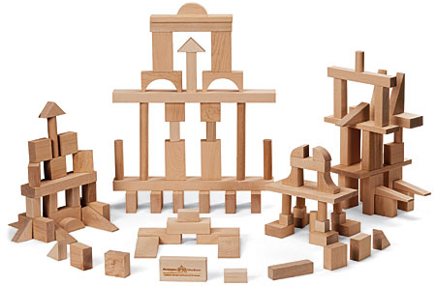
Man-made Objects
Notes:
Mechanical parts mostly consist of simple primitives arranged together while adhering to precise global inter-part relations that naturally arise from design and fabrication considerations.
Thus, seemingly complex man-made objects may have low information content consisting of primitive parts conforming to global relations.

Slide 7
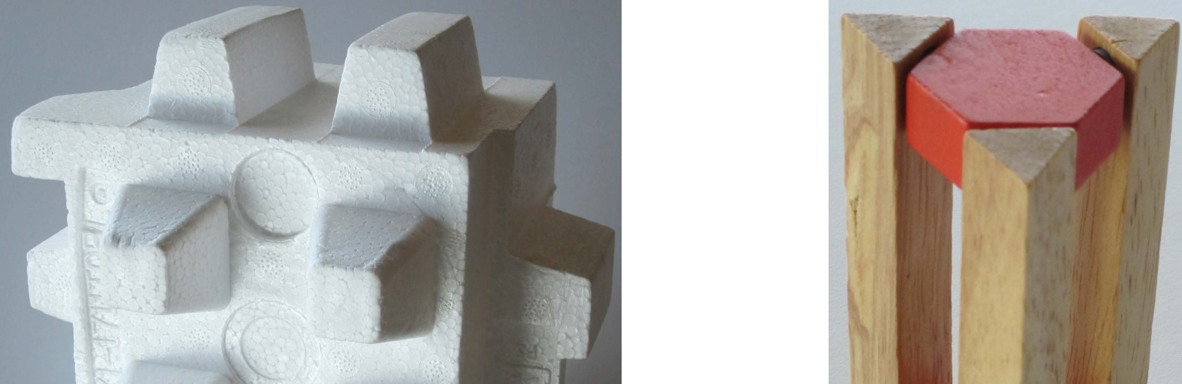
Regularity in Objects
equal length
equal angle
parallel faces
coplanar
orthogonal faces
Notes:
Such relations not only manifest as parallel faces, orthogonal faces and coplanar faces, but also as precise equality of attributes such as length and angle across primitives, both neighboring and distant.
In noisy, possibly incomplete, scanned data, such relations, which are critical to the functionality of the original objects, are easily subdued and lost. Precise recovery of such relations remains challenging for low fidelity scans.
We found that the primitives and their global mutual relations can be used as priors to cover the shortage of scan imperfection and guide the reconstruction process, thus we proposed a method that simultaneously recovers a set of locally fitted primitives along with their global mutual relations from point cloud.
Yangyan will introduce more details on the algorithm.

Slide 8
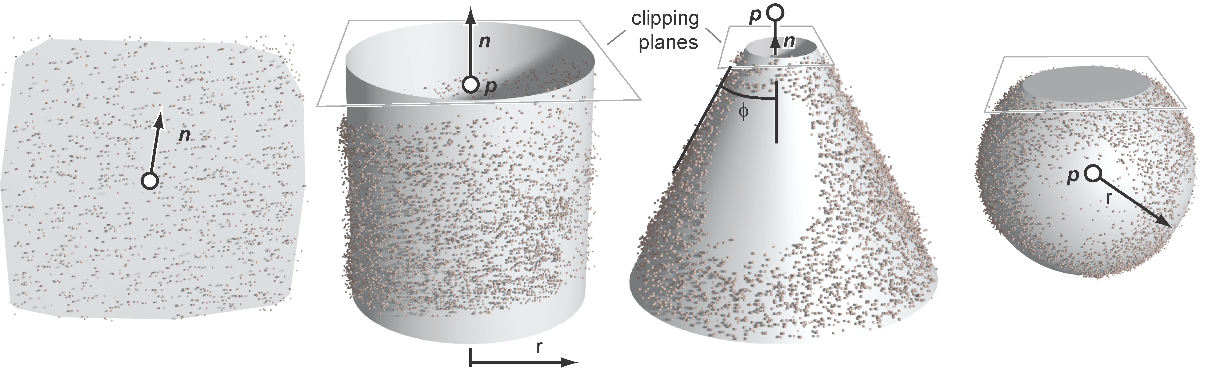




Primitives (and attributes)
($n$, $d$)
($n$, $p$, $r$)
($n$, $p$, $φ$)
($p$, $r$)
Notes:
Thanks, Niloy!
Since most of the man-made objects are composed of simple primitives, for example, plane, cylinder, cone and sphere, the objects can be reconstructed through recovering of such primitives.
The primitives are extracted from point cloud and each kind represented by corresponding parameters as shown below.
Then the parameters are optimized to get better fitting of the primitives.

Slide 9
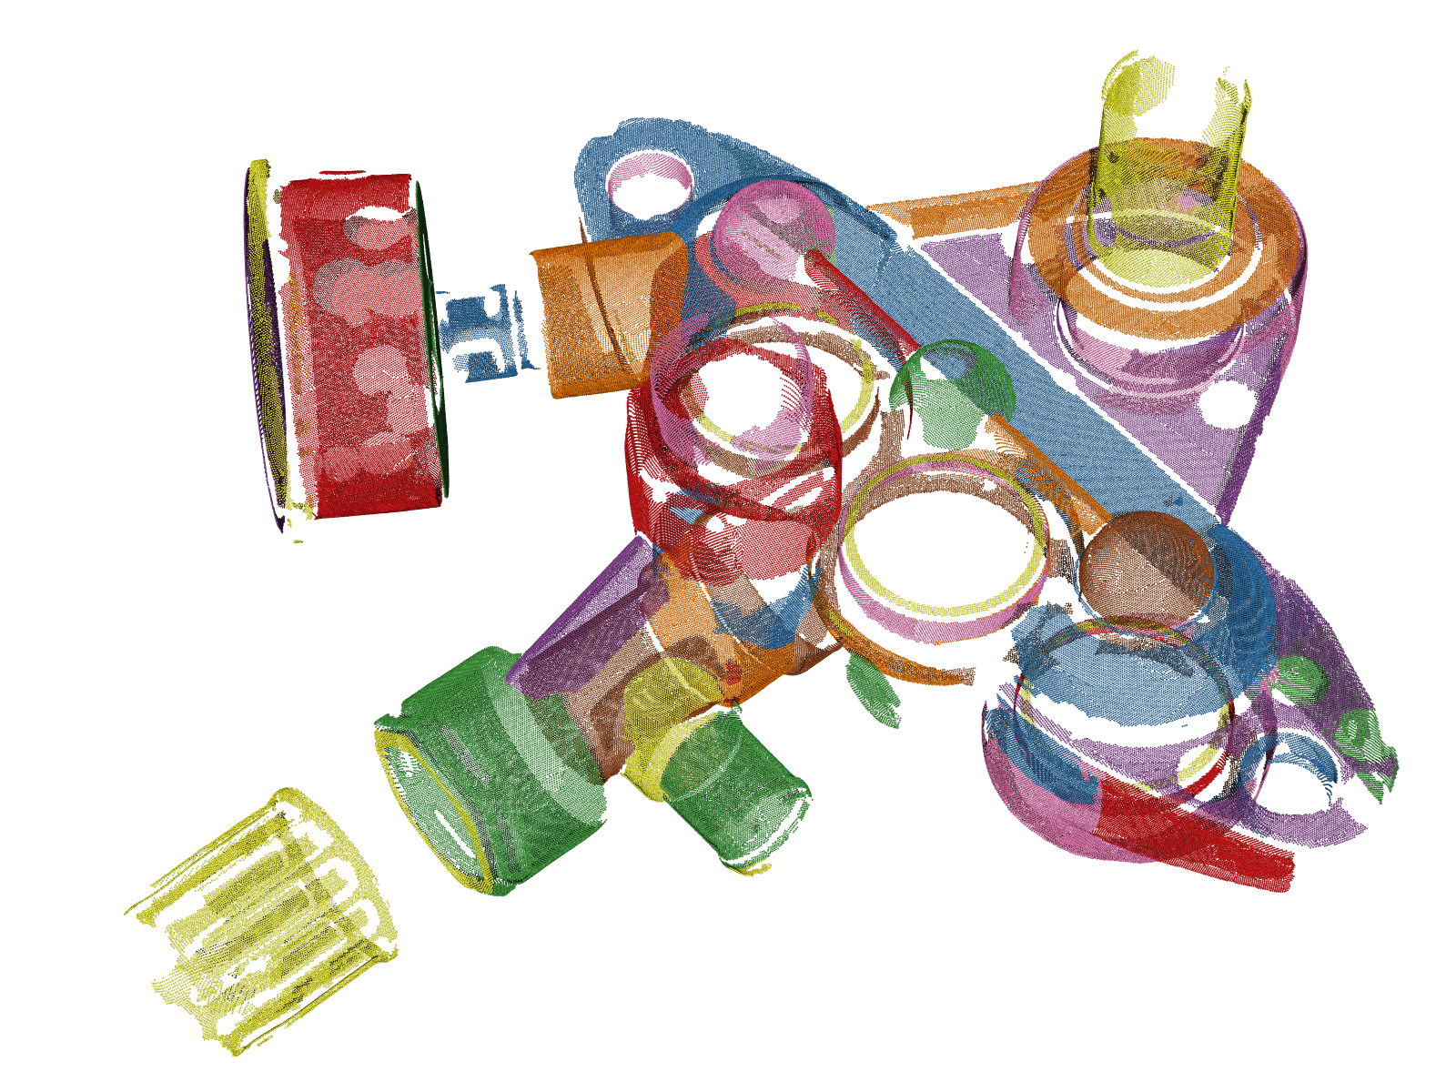
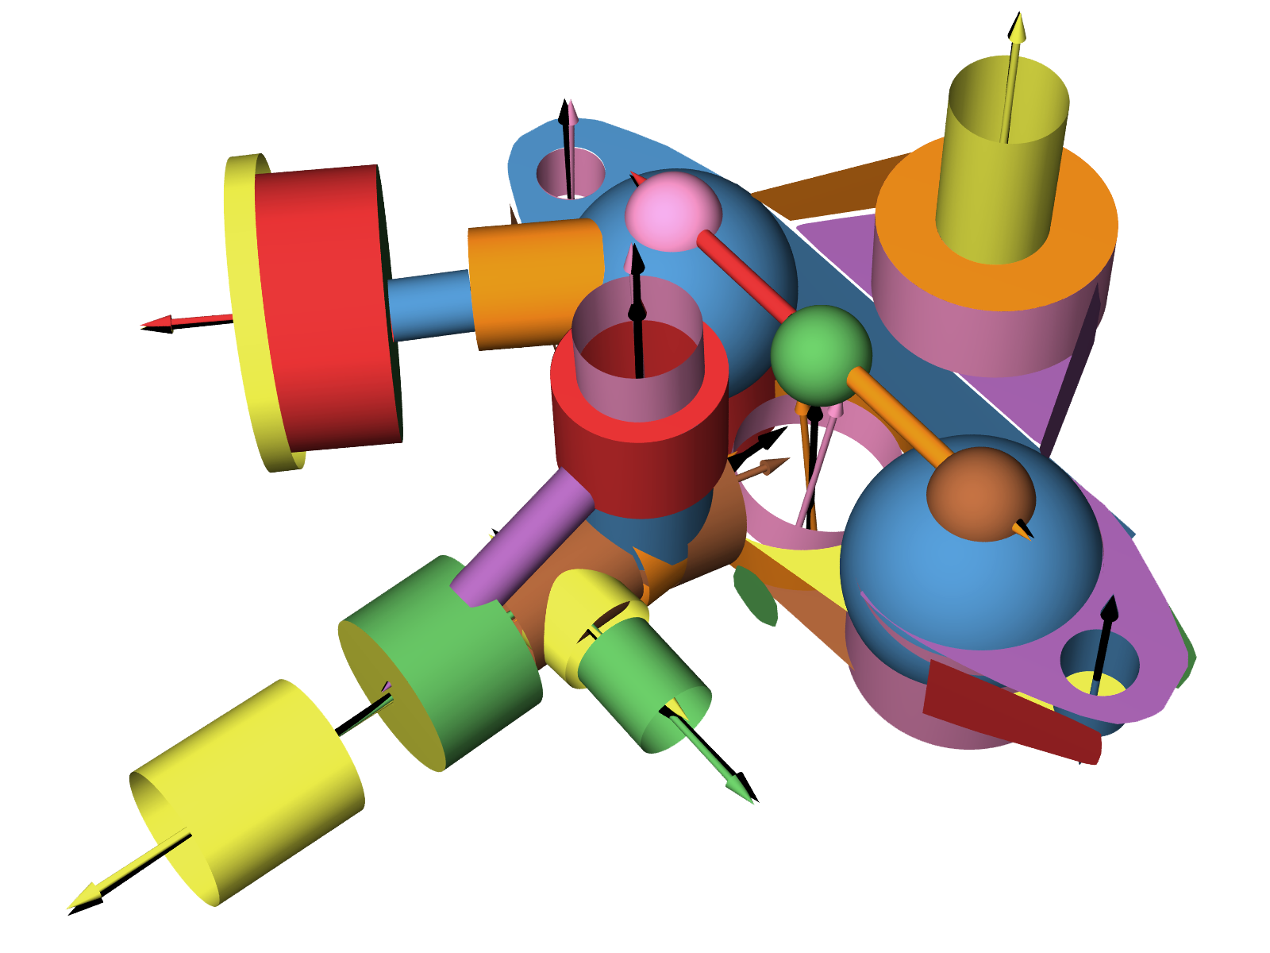
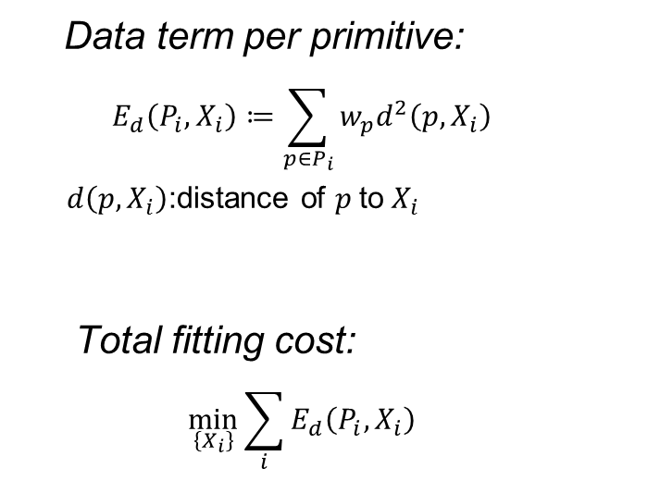

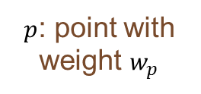

Local Primitive Fitting
Data term per primitive:
  $$E_{d}\left(P_{i},X_{i}\right)≔\sum_{p∈P_{i}}{w_{p}d^{2}\left(p,X_{i}\right)}$$
  $d\left(p,X_{i}\right)$:distance of $p$ to $X_{i}$
Total fitting cost:
  $$\min_{\left\{X_{i}\right\}}{\sum_{i}{E_{d}\left(P_{i},X_{i}\right)}}$$
$P_{i}$: points group $i$
$p$: point with weight $w_{p}$
$X_{i}$: primitive of $P_{i}$
Notes:
In state-of-the-art reconstruction approaches, local primitive fitting is applied.
The point cloud consists of thousands to millions of points, each denoted as p with weight wp.
Then the point cloud is partitioned to tens of point groups Pi, each has an associated primitive Xi.
Based on the groups and primitives, the data fitting error of group is defined as the sum of weighted distances from point to the primitive.
The data fitting error is minimized to make the primitives align best to the points.
Note that, since the groups are separated, the fitting is local: the best fitting of each group is determined by the data of each group only. Groups with higher data support generate good results, while groups with lower data support produce poor results. For example, groups of smaller elements usually suffer more from biased samples or interfere from neighboring parts, and have relatively larger noise, which lead to poor results.

Slide 10
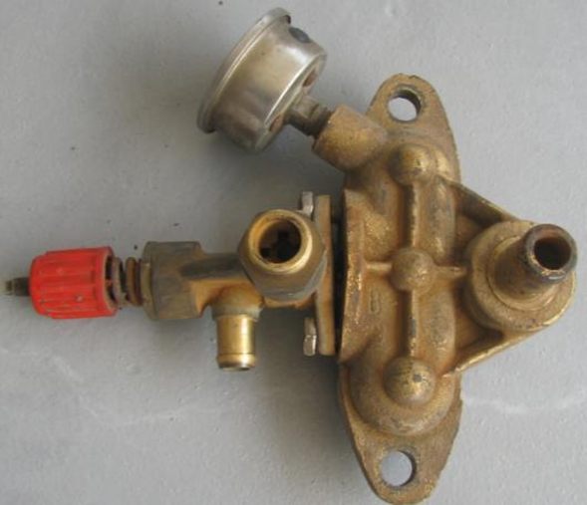





Discover Global Relations
$$g_{c}≔n_{i}−n_{j}≈0$$
near parallel
$$g_{c}≔n_{i}−n_{j}=0$$
parallel
$$g_{c}≔ d_{i}∙n_{i}−d_{j}∙n_{j}≈0$$
RANSAC
near coplanar
near …
$$g_{c}≔n_{i}∙n_{j}≈0$$
near orthogonal
$${g_{c}≔({\overset{⃑}{p_{i}p_{j}}∙n}_{i})}^{2}−{\left\|p_{i}p_{j}\right\|}^{2}≈0$$
near coaxial
Point Cloud
Initial Primitives
Notes:
Given a noisy and incomplete point set, a set of initial locally fitted primitives are extracted by RANSAC.
Then we discover the global relations by checking the regularities between all pairs of primitives.
Due to the scanning imperfection, precise relations between primitives are subdued: those “exact” relations in origin object may appear as “near” relations. So the algorithm first learns the “near” relations in the primitives, then try to recover the “exact” relations of the origin object.
For each kind of relation, we have an implicit function gc to measure how well the relation holds, if the gc approximates to 0 under a threshold, we consider the primitives have a near relation. Here the red and yellow cylinders are considered to be near parallel.
When gc exactly equals to 0, the relation is exactly satisfied, thus we can obtain exact relations by constraining gc to 0. Here the yellow and purple cylinders are exactly parallel.
Global relations such as orthogonal, coplanar, coaxial and so on are discovered in the same way.
However, there can be n^2 candidate relations for n primitives since the relations are across primitives both neighboring and distant, and there can be correct relations as well as false ones, which makes it very challenging to discover.

Slide 11
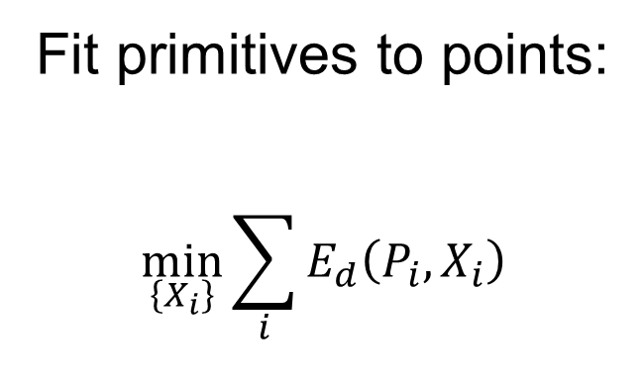

Consistent Primitive Fitting
Fit primitives to points
and relations:
$$\min_{\left\{X_{i}\right\}}{\sum_{i}{E_{d}\left(P_{i},X_{i}\right)}}$$
$$such that all g_{c}=0$$
Fit primitives to points:
$$\min_{\left\{X_{i}\right\}}{\sum_{i}{E_{d}\left(P_{i},X_{i}\right)}}$$
Notes:
The local primitive fitting only takes account of data fitting error, thus the result only respects to the points.
In our consistent primitive fitting, the global relation priors are employed. The data fitting error is minimized such that all gc equal to 0, so the results respect to the points and the relations are exactly satisfied.
And since the groups are connected through the global relations, all primitives are optimized together to achieve overall optimal.
This is a non-linear optimization problem, and we solve it with a trust region method based on interior point nonlinear programming.
Note that there is always a balance between data and relations – sometimes, for example, when the data is very poor, we fit more to relations.

Slide 12









Primitive Fitting + Global Relations
$$g_{c}≔n_{i}−n_{j}=0$$
$$g_{c}≔n_{i}−n_{j}≈0$$
exact parallel
near parallel
$$g_{c}≔n_{i}−n_{j}=0$$
$$g_{c}≔n_{i}−n_{j}=0$$
exact parallel
parallel
$$g_{c}≔ d_{i}∙n_{i}−d_{j}∙n_{j}=0$$
$$g_{c}≔ d_{i}∙n_{i}−d_{j}∙n_{j}≈0$$
exact coplanar
GlobFit
near coplanar
exact …
near …
$$g_{c}≔n_{i}∙n_{j}=0$$
$$g_{c}≔n_{i}∙n_{j}≈0$$
Global Relations
exact orthogonal
near orthogonal
$${g_{c}≔({\overset{⃑}{p_{i}p_{j}}∙n}_{i})}^{2}−{\left\|p_{i}p_{j}\right\|}^{2}=0$$
$${g_{c}≔({\overset{⃑}{p_{i}p_{j}}∙n}_{i})}^{2}−{\left\|p_{i}p_{j}\right\|}^{2}≈0$$
exact coaxial
near coaxial
Aligned Primitives
Initial Primitives
Notes:
Here I summarize the process a bit.
Start from point cloud, initial primitives along with their global relation are learned, but not fed apriori.
Then the primitives are aligned and the relations are turned from “near” to “exact”, since our GlobFit couples the local and global aspects and consistently fits primitive respecting to both the points and the global relation priors.

Slide 13
















Types of Relations
Orientation
Relations
$X_{i}∥X_{j}$
$X_{i}⊥X_{j}$
$X_{i}∥X_{j}$
$∠X_{i}X_{j}=∠X_{k}X_{l}$
Coaxial($X_{i}$,$X_{j}$)
Eq. radii($X_{i}$,$X_{j}$)
Placement
Relations
$X_{i}⊥X_{j}$
Coaxial($X_{i}$,$X_{j}$)
Coplanar($X_{i}$,$X_{j}$)
Coplanar($X_{i}$,$X_{j}$)
Eq. angle($X_{i}$,$X_{j}$)
$∠X_{i}X_{j}=∠X_{k}X_{l}$
Equality
Relations
Eq. radii($X_{i}$,$X_{j}$)
$\left|X_{i}X_{j}\right|=|X_{k}X_{l}|$
Eq. angle($X_{i}$,$X_{j}$)
$\left|X_{i}X_{j}\right|=|X_{k}X_{l}|$
Notes:
Various global relations are considered in our system, among which some are easier or more stable than others. So we order them to 3 categories, then we learn and conform to them progressively.
Also note that some relations involve 2 primitives while others involve 4 primitives.

Slide 14
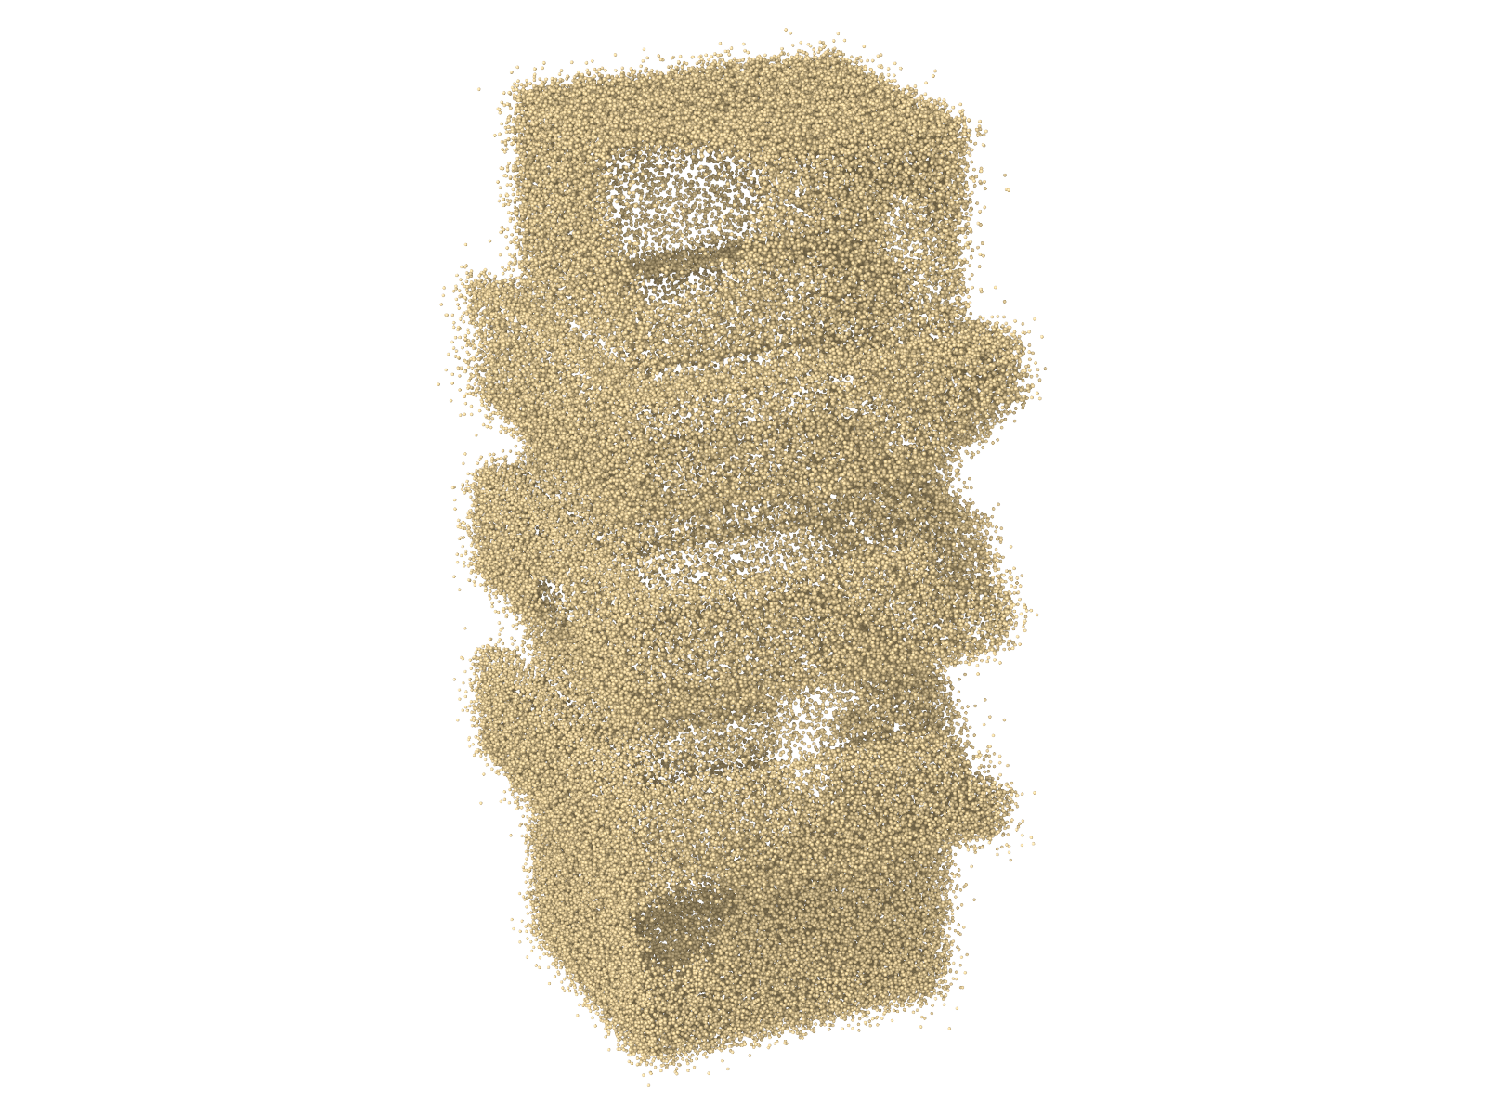

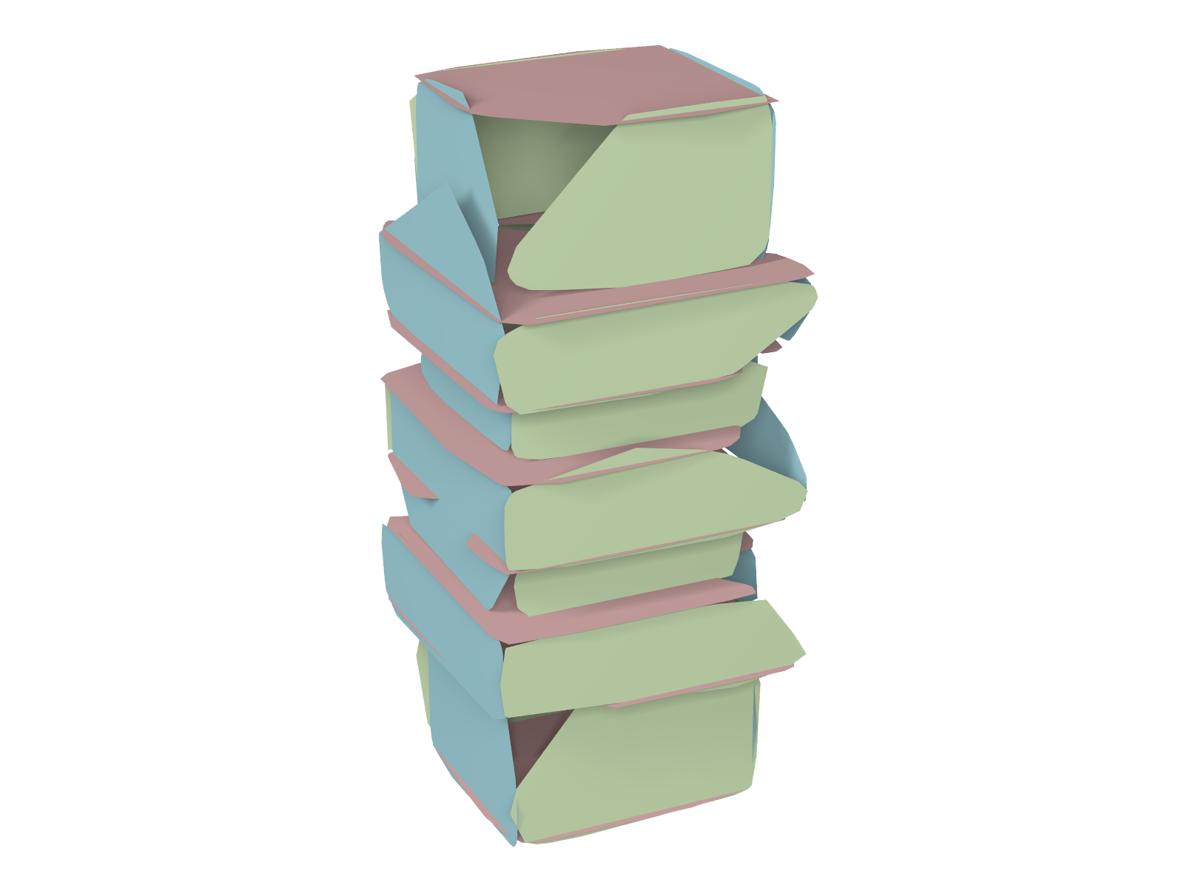



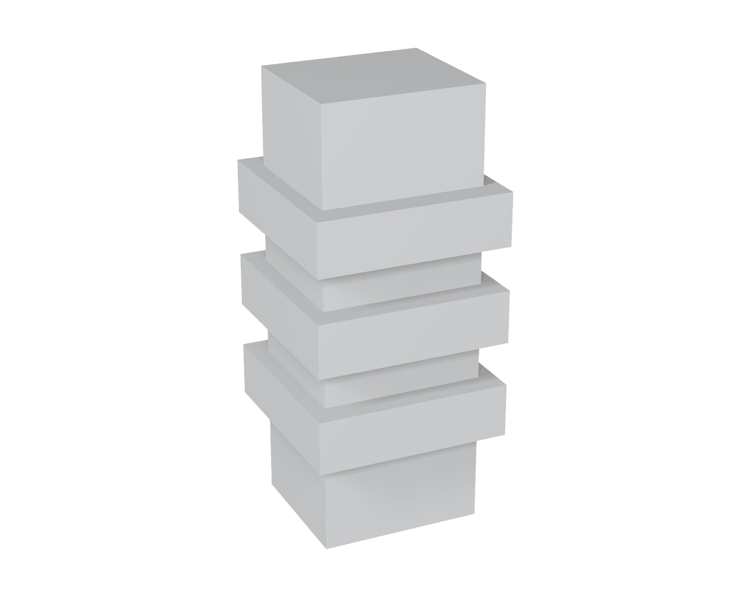
GlobFit Pipeline
Orientation Alignment
Placement Alignment
No
Alignment to Global Relations
Equality Alignment
RANSAC
Converged?
re-RANSAC
Yes
d
d
New
Plane
d
Colored by Primitive
Colored by Orientation
Colored by Coplanar
Colored by Coplanar
Notes:
Here is the full pipeline of our system.
Start from a noisy and incomplete point set, RANSAC is applied to get a set of initial locally fitted primitives.
In the orientation alignment stage, parallel, orthogonal and equal angle are learned and conformed to, as the 3 orientations shown here.
Then comes placement alignment stage, coaxial and coplanar relations are learned and conformed to, as the two of the coplanar groups shown here.
Finally, the equality alignment stage, equal radius, equal angle and equal length are learned and conformed to, as equal length shown here.
We perform global alignments one after another, while always accounting for the underlying data, and respecting relations already conformed to in the previous stages. Note that there can be redundancies and conflicts in the relations discovered in each stage, reduction is applied to resolve such problems.
Once the primitives are aligned, the points to primitives mapping is updated, then we have better chance to detect those smaller primitives being overwhelmed by the bigger ones in previous RANSAC stage, as shown here, the red plane is detected, so it’s not converged.
And the new plane is added and another round of global alignments is applied.
When no more new primitives can be detected, the algorithm converges and the final result is visualized with the fitted planes clipped by neighboring ones.

Slide 15















Redundancy/Conflicts in Constraints Set
$$F$$
$X_{B}⊥X_{D}$:0.1
$$E$$
$X_{A}⊥X_{B}$:0.8
$X_{C}⊥X_{D}$:0.3
$$A$$
$X_{A}∥X_{E}$:0.9
$X_{A}∥X_{F}$:0.6
$X_{A}⊥X_{D}$:0.2
$X_{B}⊥X_{C}$:0.7
$X_{E}∥X_{F}$:0.4
$X_{A}⊥X_{C}$:0.5
$$B$$
… : …
$$D$$
collected constraints set
$$C$$
Notes:
However, the collected constraints set is not ideal for the non-linear solver.
First, it consists of redundancies. For example, A is parallel to both E and F, which implies E and F are parallel, thus the constraint to enforce E and F to be parallel is redundant. These redundancies should be removed to improve the efficiency.
Second, but more importantly, some constraints are incompatible with others, making it impossible to get all the relations simultaneously satisfied. For example, here the six orthogonal relations can not exist together. Such conflicts should be removed to prevent the rotten apple spoiling the barrel.
A maximal subset of relations without any redundancies and conflicts is ideal for the solver, but it’s NP hard to extract such subset in general cases.
Here, since we have geometry properties in this special case, an iterative approximation is used to progressively extract such a conflict-free subset.

Slide 16









Example: Constraints Reduction
$X_{A}∥X_{E}$: 0.9
$$F$$
$X_{B}⊥X_{D}$:0.1
$$E$$
$X_{A}⊥X_{B}$:0.8
$X_{A}⊥X_{B}$:0.8
$X_{B}⊥X_{C}$:0.7
$X_{C}⊥X_{D}$:0.3
( )
$X_{A}∥X_{F}$: 0.6
$$A$$
$X_{A}∥X_{E}$:0.9
$X_{A}∥X_{F}$:0.6
$X_{A}⊥X_{C}$:0.5
$X_{A}⊥X_{D}$:0.2
$X_{B}⊥X_{C}$:0.7
$X_{E}∥X_{F}$: 0.4
$X_{E}∥X_{F}$:0.4
$X_{A}⊥X_{C}$:0.5
$$B$$
$X_{C}⊥X_{D}$:0.3
… : …
$$D$$
$X_{A}⊥X_{D}$:0.2
$X_{B}⊥X_{D}$:0.1
Collected Constraints Set
… : …
$$C$$
Sorted Constraints
Notes:
Full detail about this procedure can be referred to the paper, here I just give a very simple case for illustrating the idea.
First, the constraints are sorted.
Then start from constraints with highest score, each constraint is checked if it can be implied by previous ones, or if it conflicts with previous ones, in which cases, the current constraint is removed.
Here A and E are parallel, so same normal parameters can be used for both E and A to reduce the number of variables to be optimized, which is called node collapse.
A B orthogonal, neither redundant nor conflict with previous ones, so it’s kept.
B C orthogonal, kept as well.
A F parallel, node collapsed.
A C orthogonal, kept.
Here comes that E and F are parallel, which is redundant, and removed.
C D orthogonal, kept.
A D orthogonal, kept as well.
At this stage, as we concluded in the paper, if two loops share an edge, here ABC and ACD share AC, then primitive B and D must be parallel.
So B D orthogonal is conflict with previous ones, and removed.
However, for relations involving with four primitives, similar reduction process can not fully remove conflicts, so we also use posteriori check to drop remaining conflicts.

Slide 17
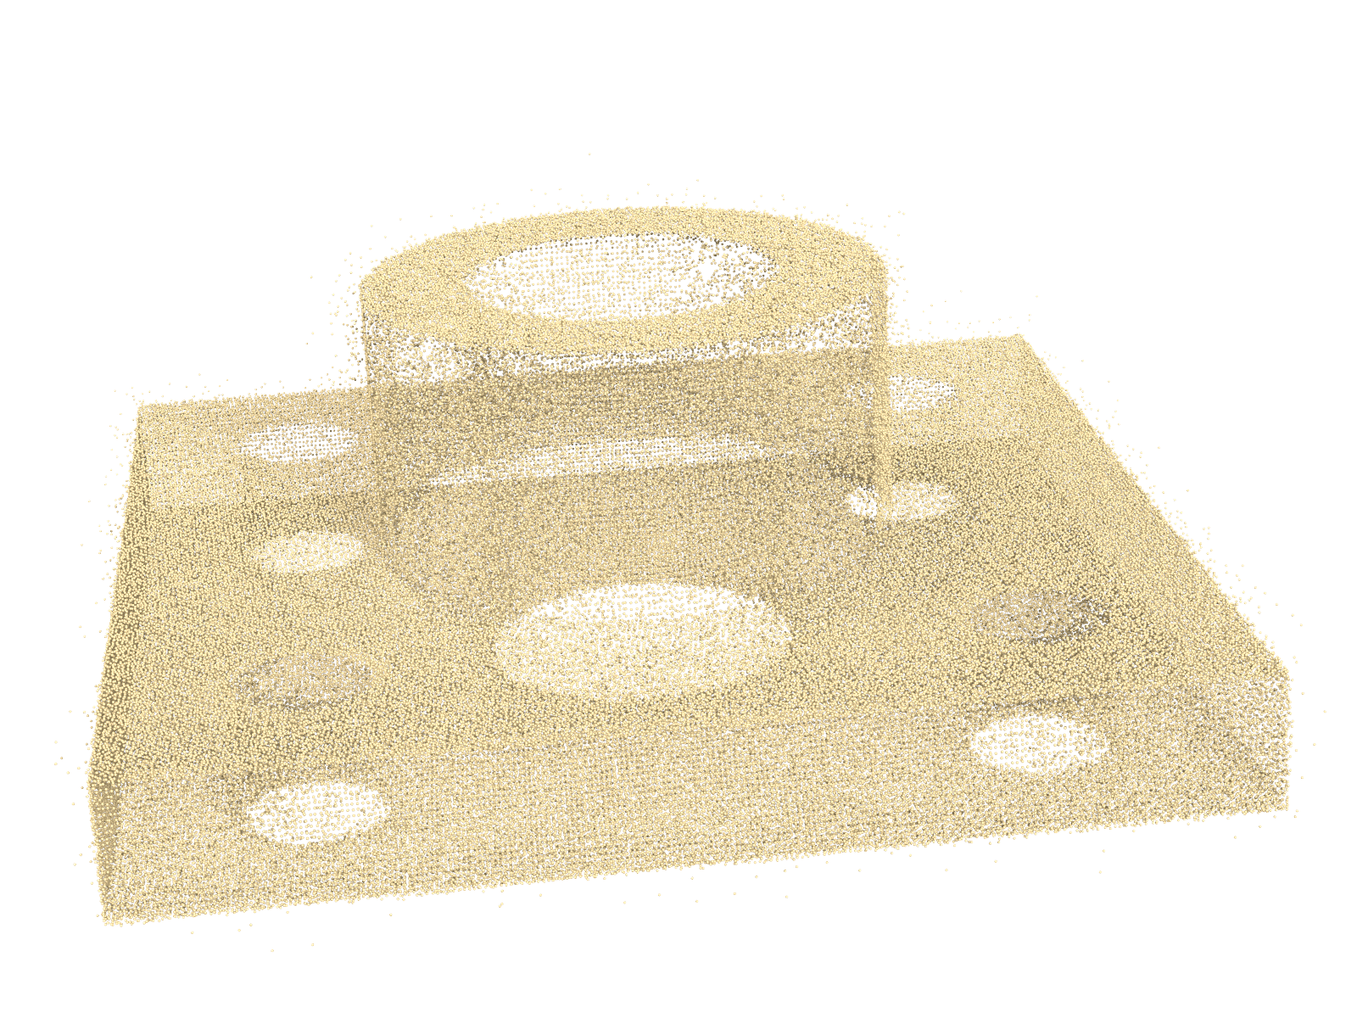
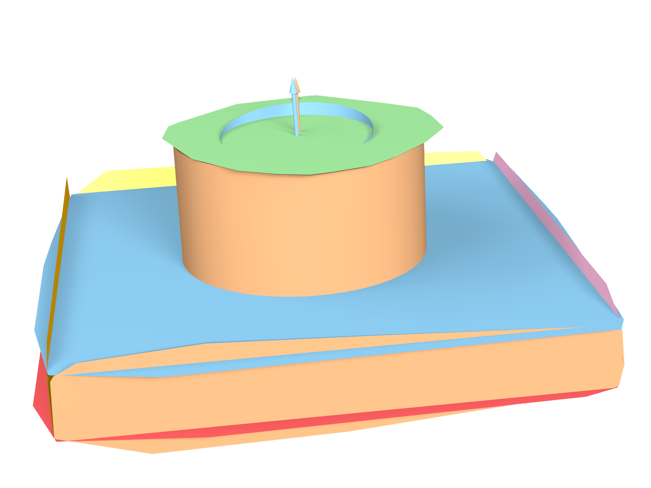
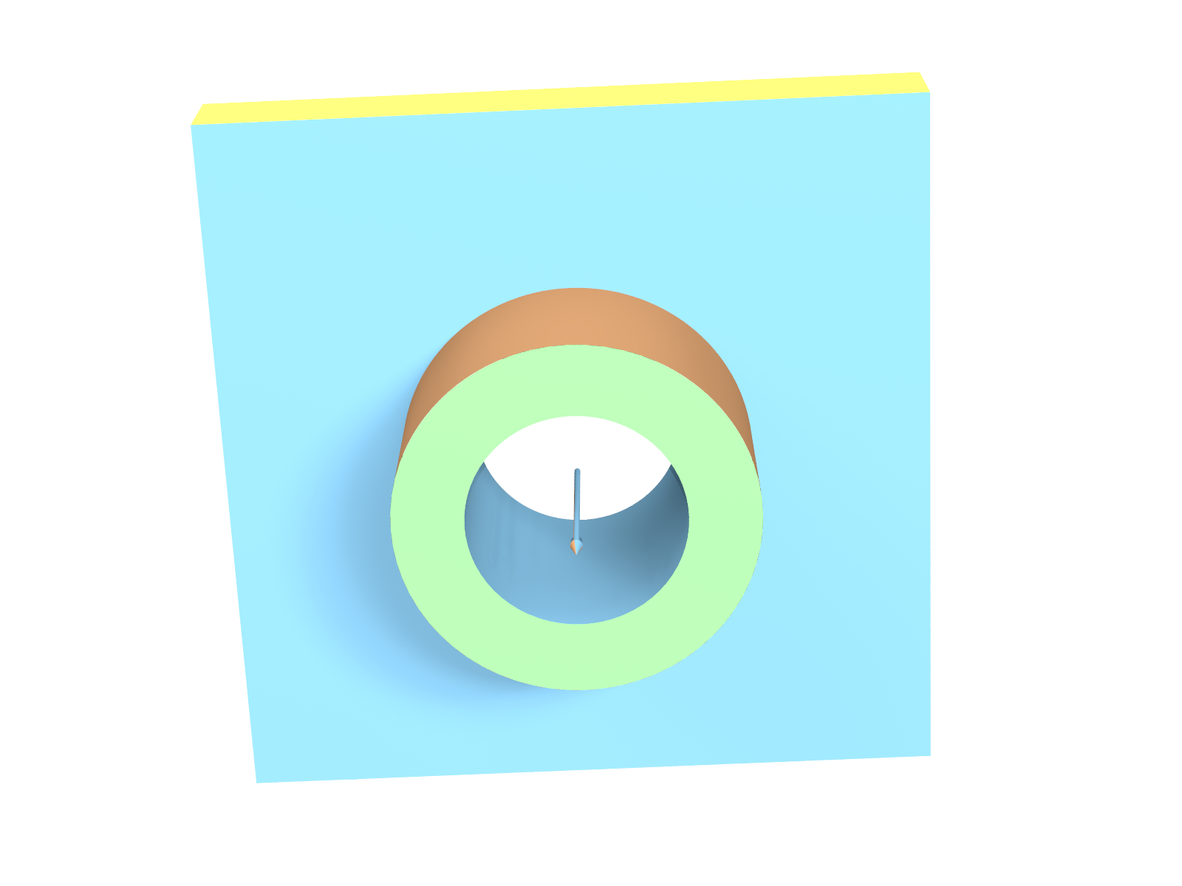

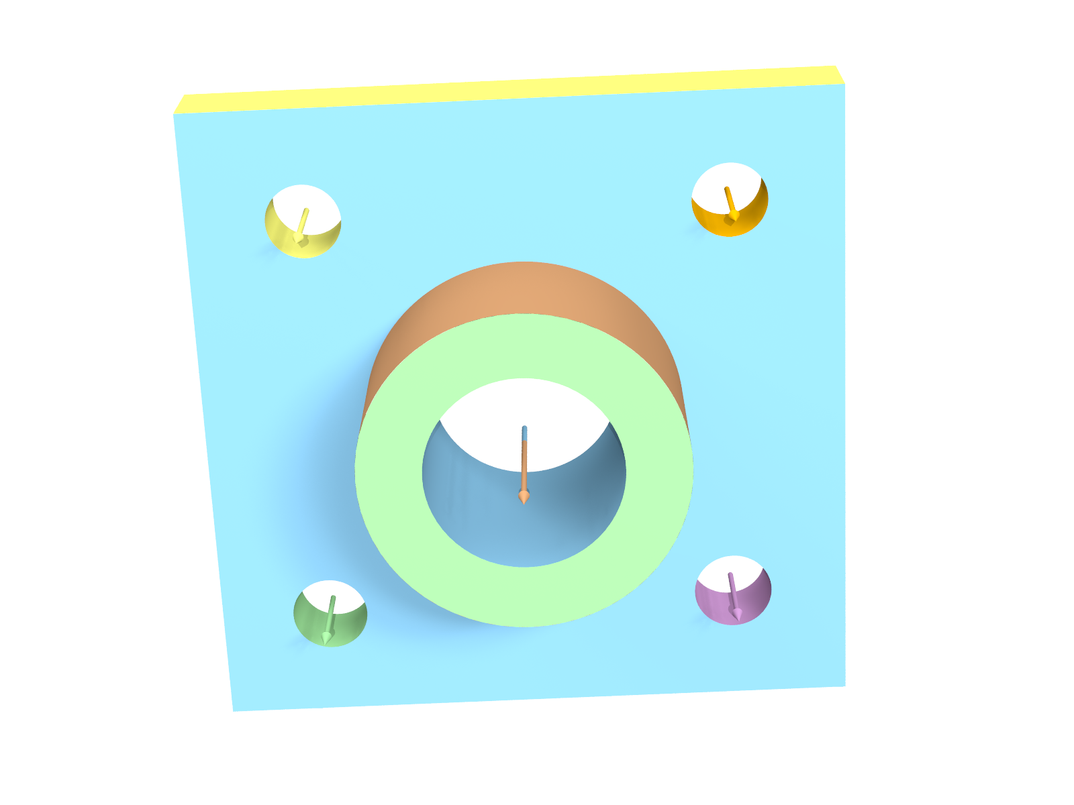
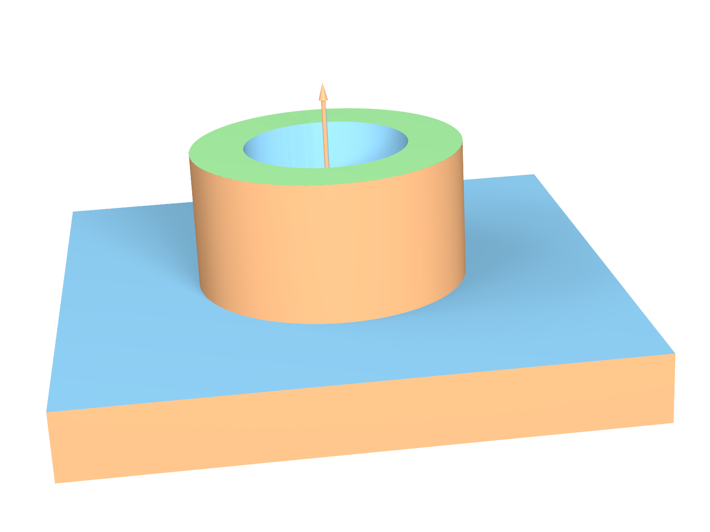
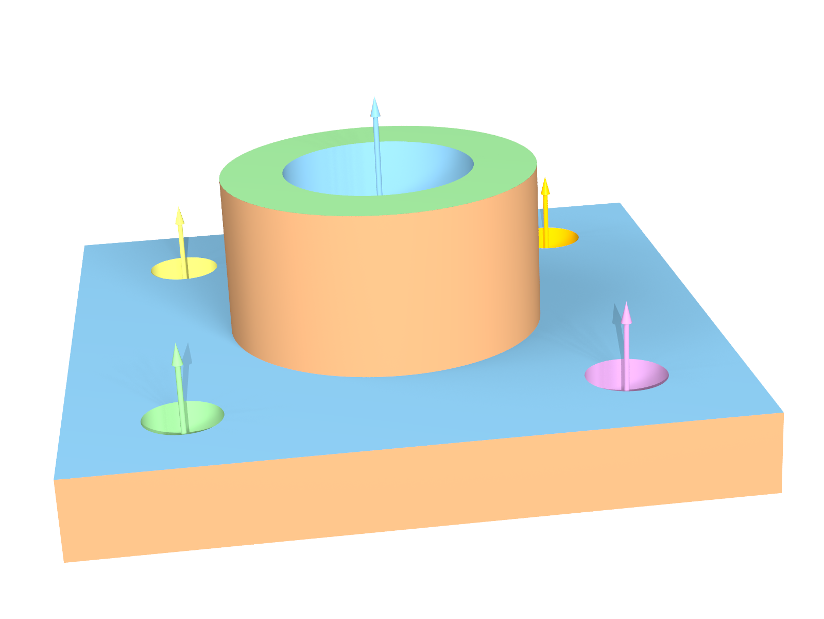
Coarse-to-fine Detection
RANSAC
Global Alignment
RANSAC
Global Alignment
Iteration #1
Iteration #2
Notes:
Non-local relations help a lot.
In our framework, the optimization proceeds from a coarse to fine scale. In the first iteration, we get the bigger primitives and align them, update points to primitives mapping. Then in the second iteration, the small cylinders are detected, which are missed in the first pass due to ambiguous points took away by the dominant surrounding planes.
As we go to finer scales, where the data is poorer, we are implicitly giving more weights to the relations. Note, this can be context sensitive, depends on how much weighting we want to assign to relations/data.

Slide 18
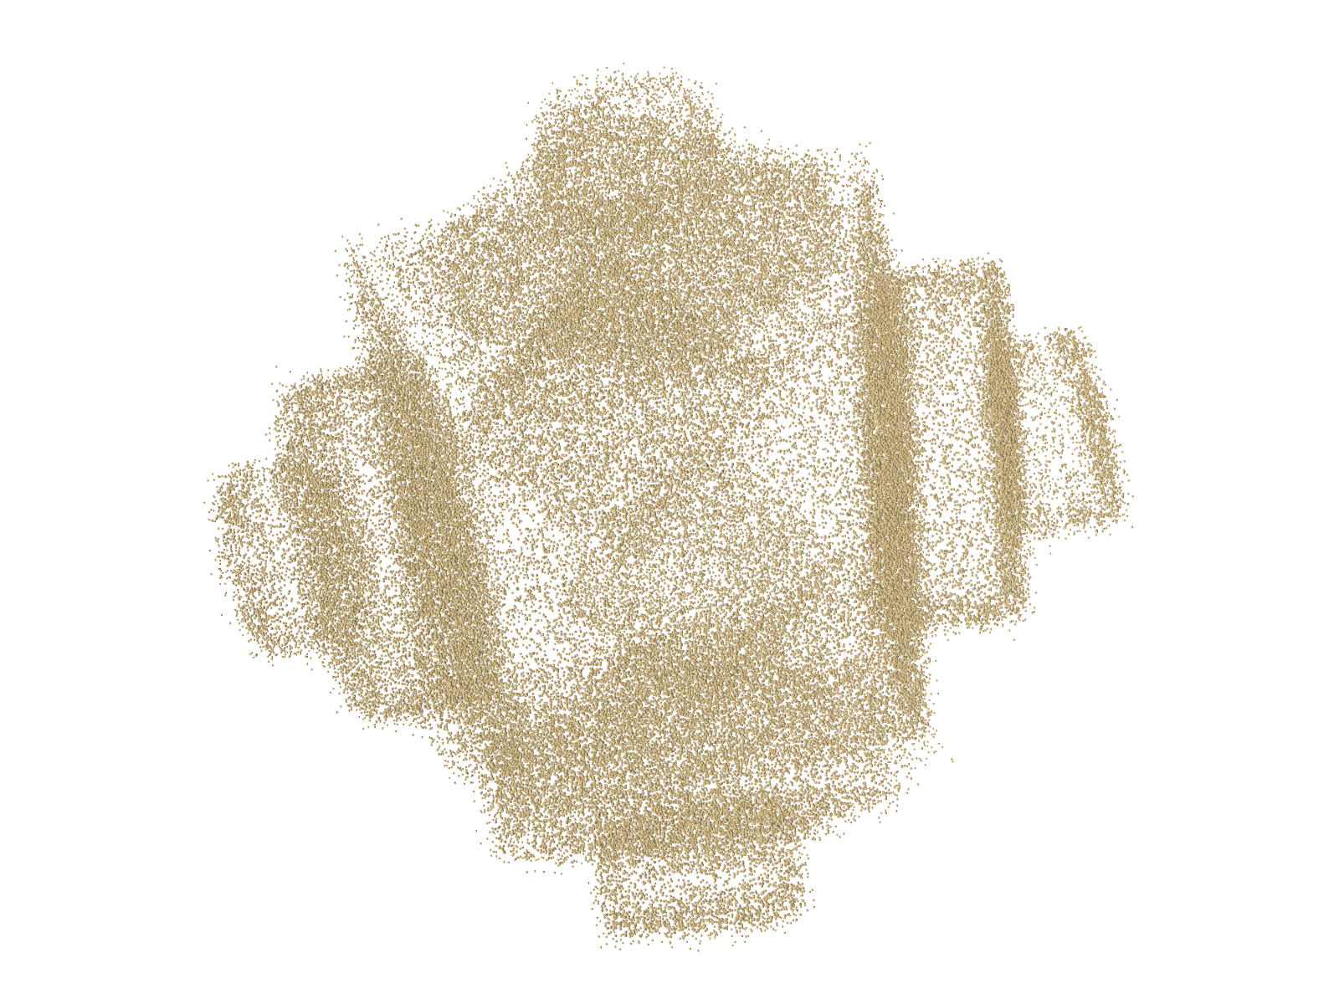
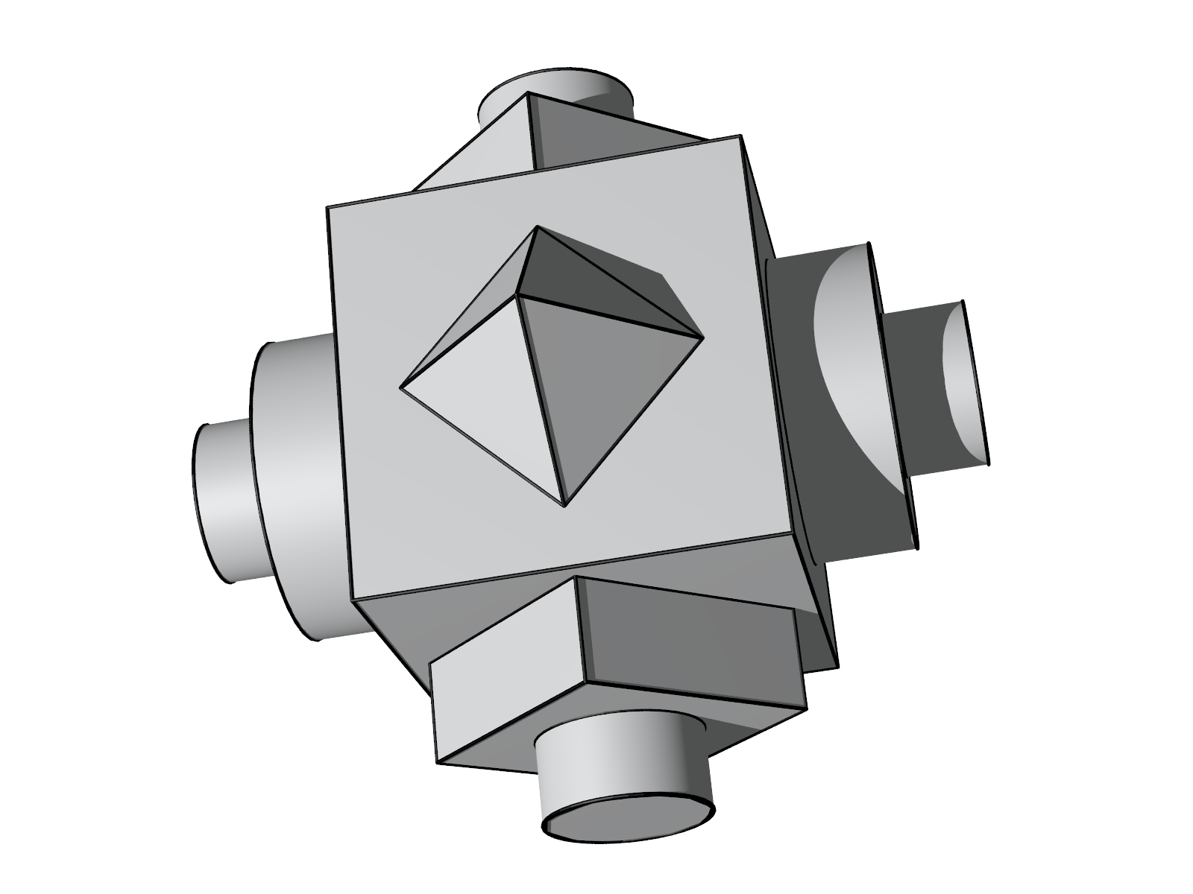
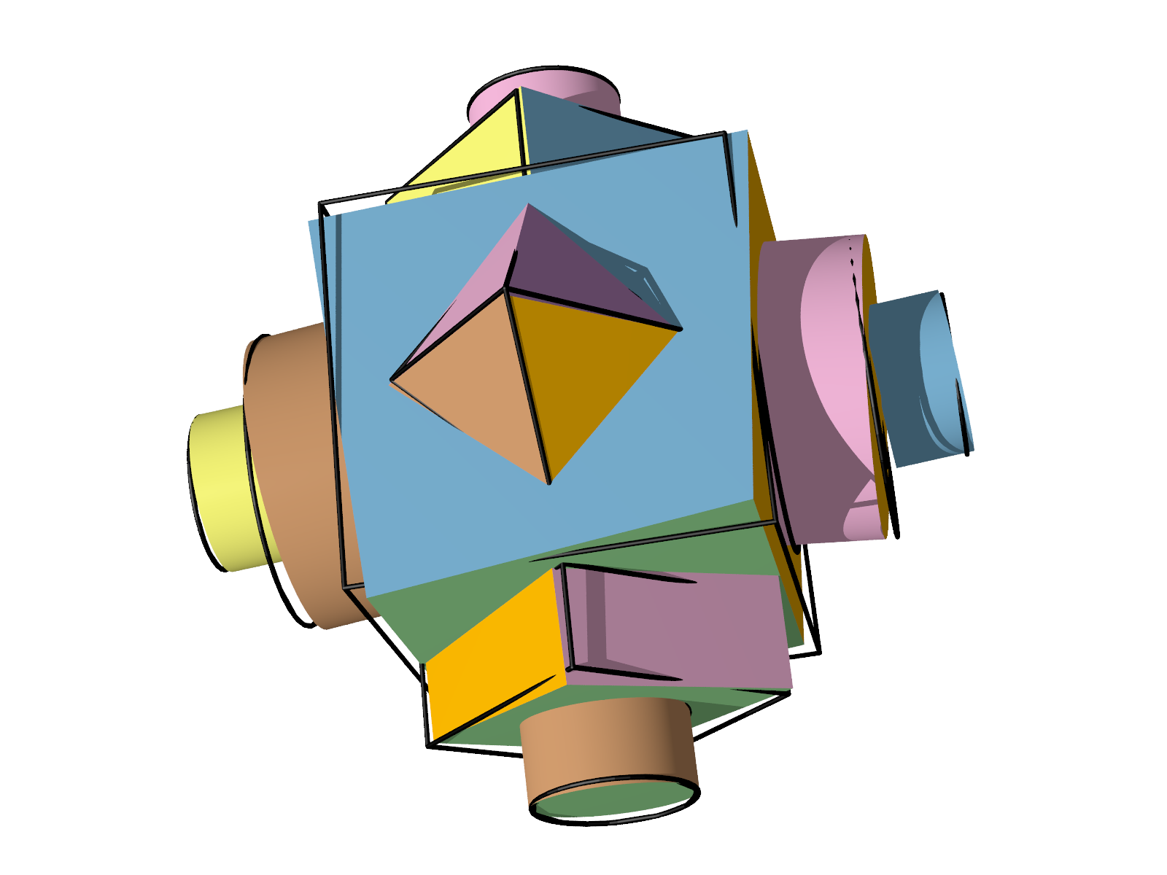
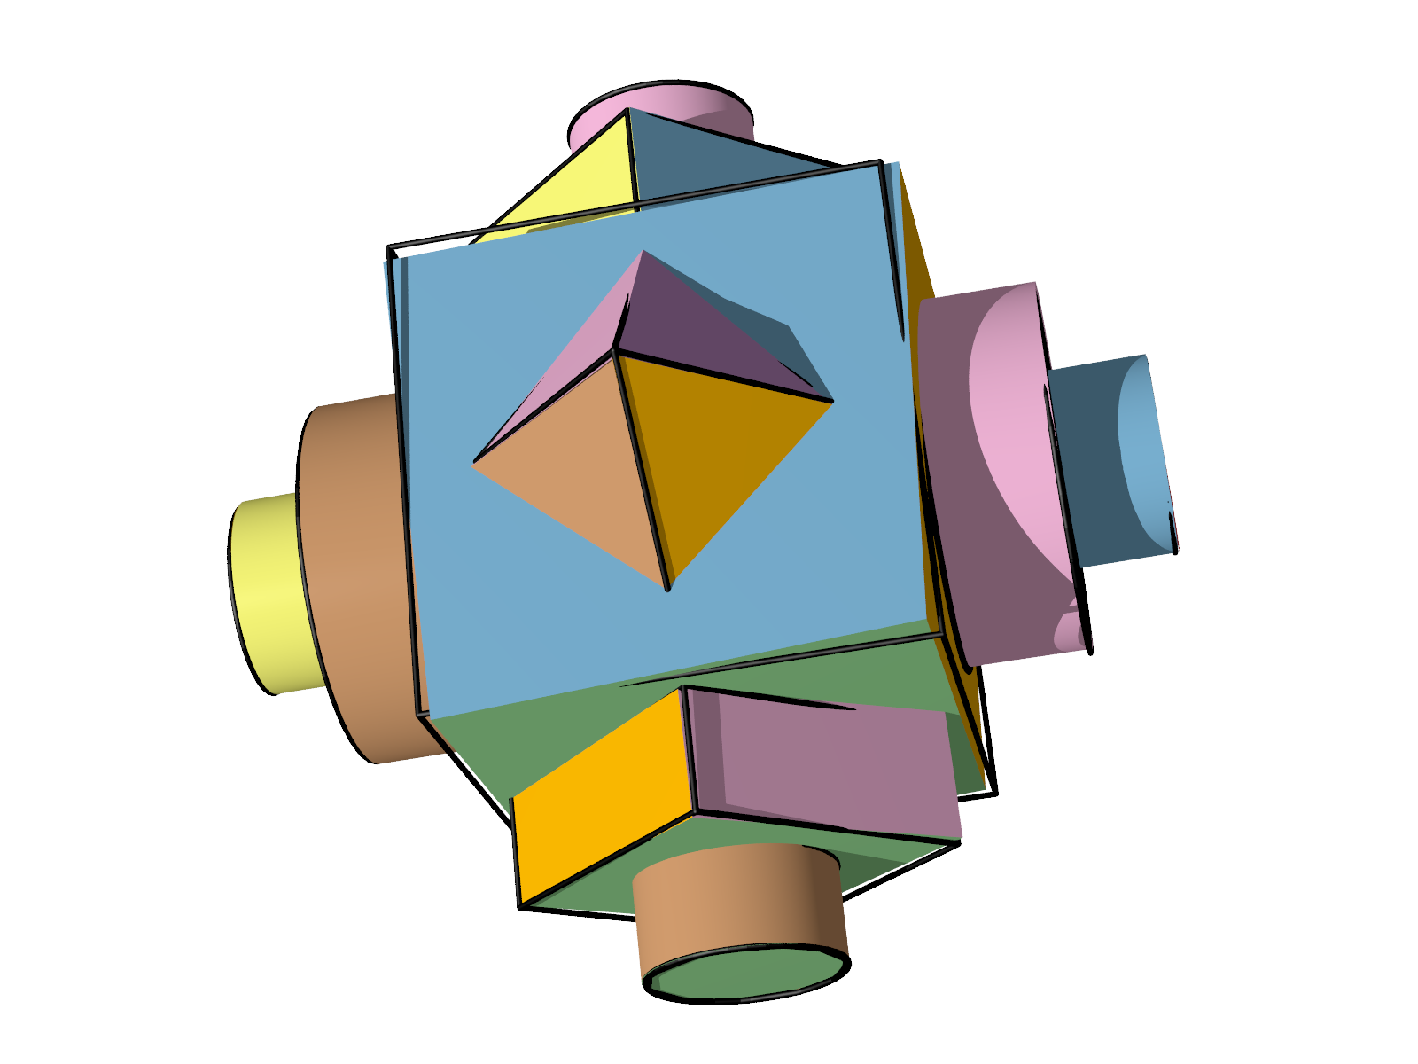
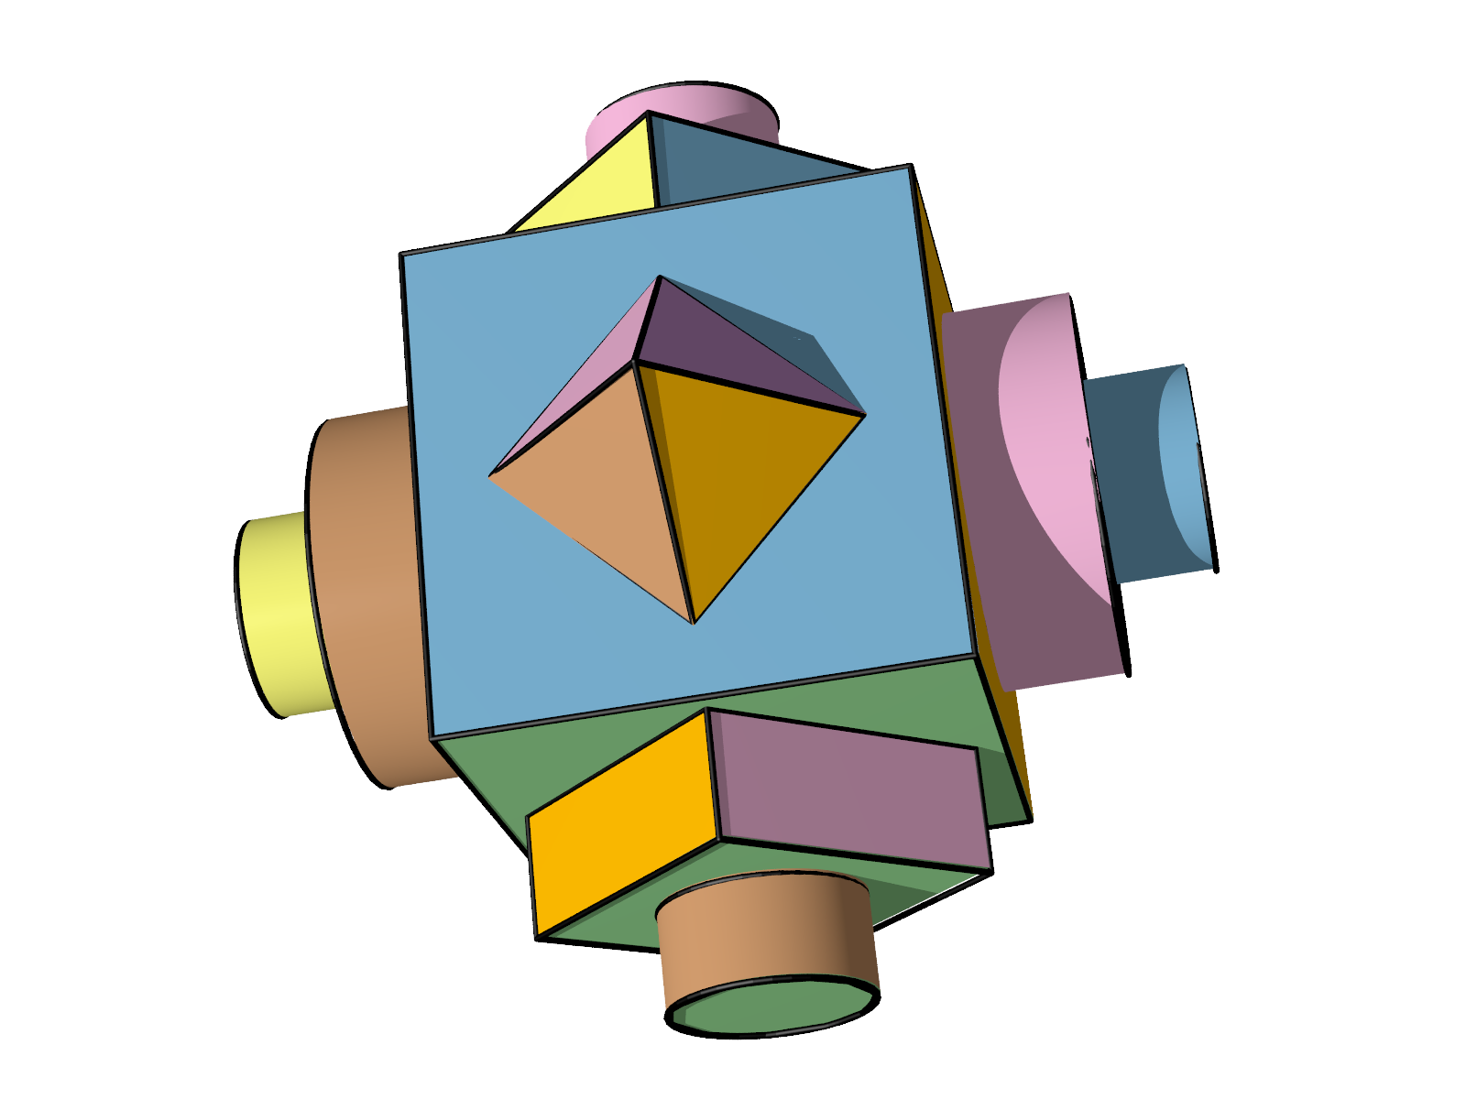
Comparison
Input points
Ground truth
Initial
RANSAC
Primitives
LS Solution
GlobFit solution
Notes:
Here we show a comparison with least square solution.
Start from the input scan with biased noise, outliers and missing regions, we get the initial RANSAC primitives. The black lines denote the ground truth, as you can see the initial RANSAC primitives are far from ground truth.
Then least square is applied to solve the data fitting error minimization problem without global constraints, which brings the primitives closer to the ground truth, but it can not reach, especially when there are conflicts.
In our result, since the relations are conflict-free, the result agrees to the data, and fully satisfies to the relations, thus get best approximation to the ground truth.
Equally important that we recover the relations that can now be used for editing (iWires), searching (Fisher), model building, etc.

Slide 19
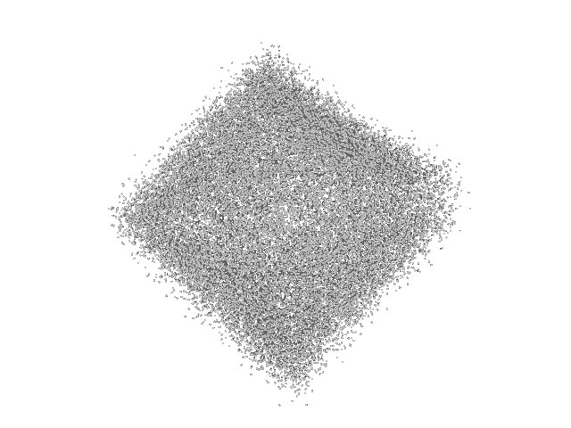
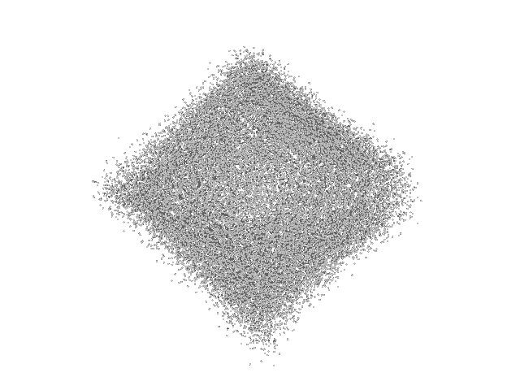
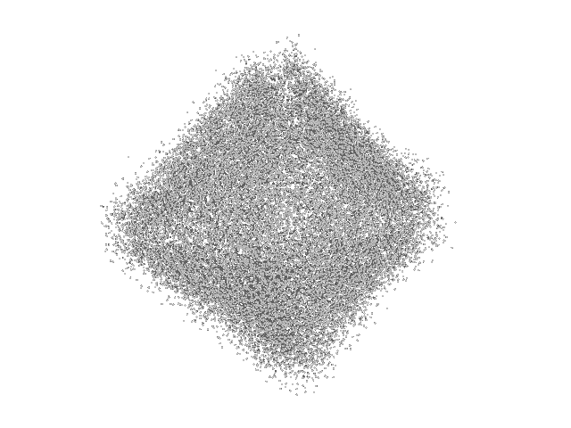
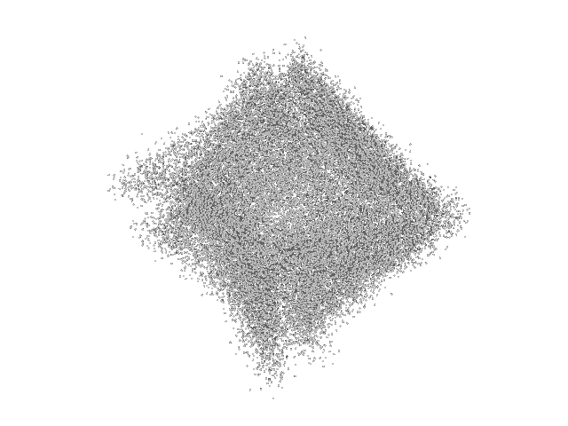
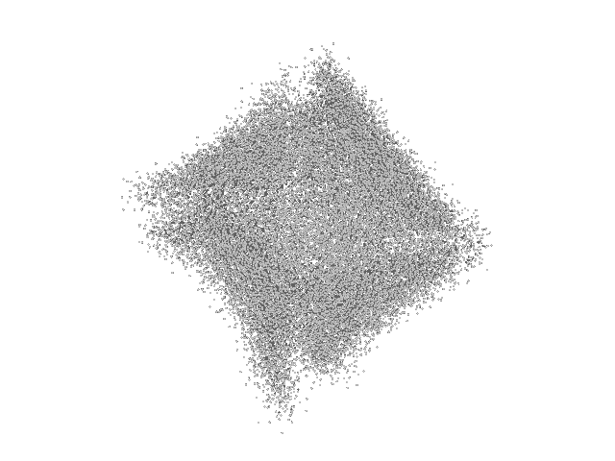
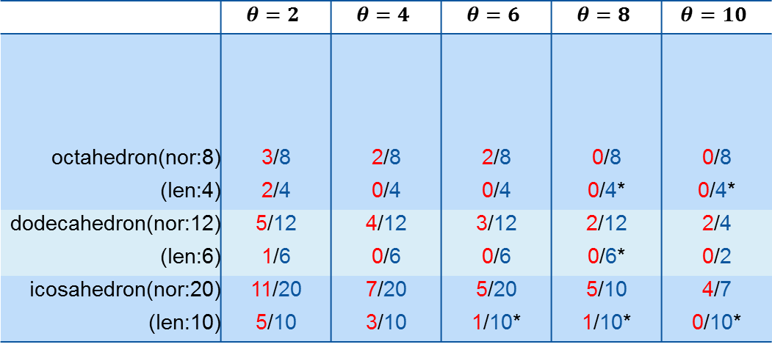
Robustness
 | $$θ=2$$ | $$θ=4$$ | $$θ=6$$ | $$θ=8$$ | $$θ=10$$
octahedron(nor:8) | 3/8 | 2/8 | 2/8 | 0/8 | 0/8
(len:4) | 2/4 | 0/4 | 0/4 | 0/4* | 0/4*
dodecahedron(nor:12) | 5/12 | 4/12 | 3/12 | 2/12 | 2/4
(len:6) | 1/6 | 0/6 | 0/6 | 0/6* | 0/2
icosahedron(nor:20) | 11/20 | 7/20 | 5/20 | 5/10 | 4/7
(len:10) | 5/10 | 3/10 | 1/10* | 1/10* | 0/10*
m/n: correctly recovered number by RANSAC(m) and GlobFit(n)
*: converged to right number but with value different from ground truth
Notes:
To test the stability of our method, we applied it on polyhedrons across varying amount of noise.
In octahedron, there are 8 different normal directions in ground truth, the number of different normal can be correctly recovered by RANSAC are listed as red numbers, while blue for GlobFit.
Also the number of different length. Under large amount of noise, our method converges to correct number, but with converged value different from the ground truth.
Here are the same test for dodecahedron and icosahedron.
As you can see here, our method is very robust against noise.

Slide 20
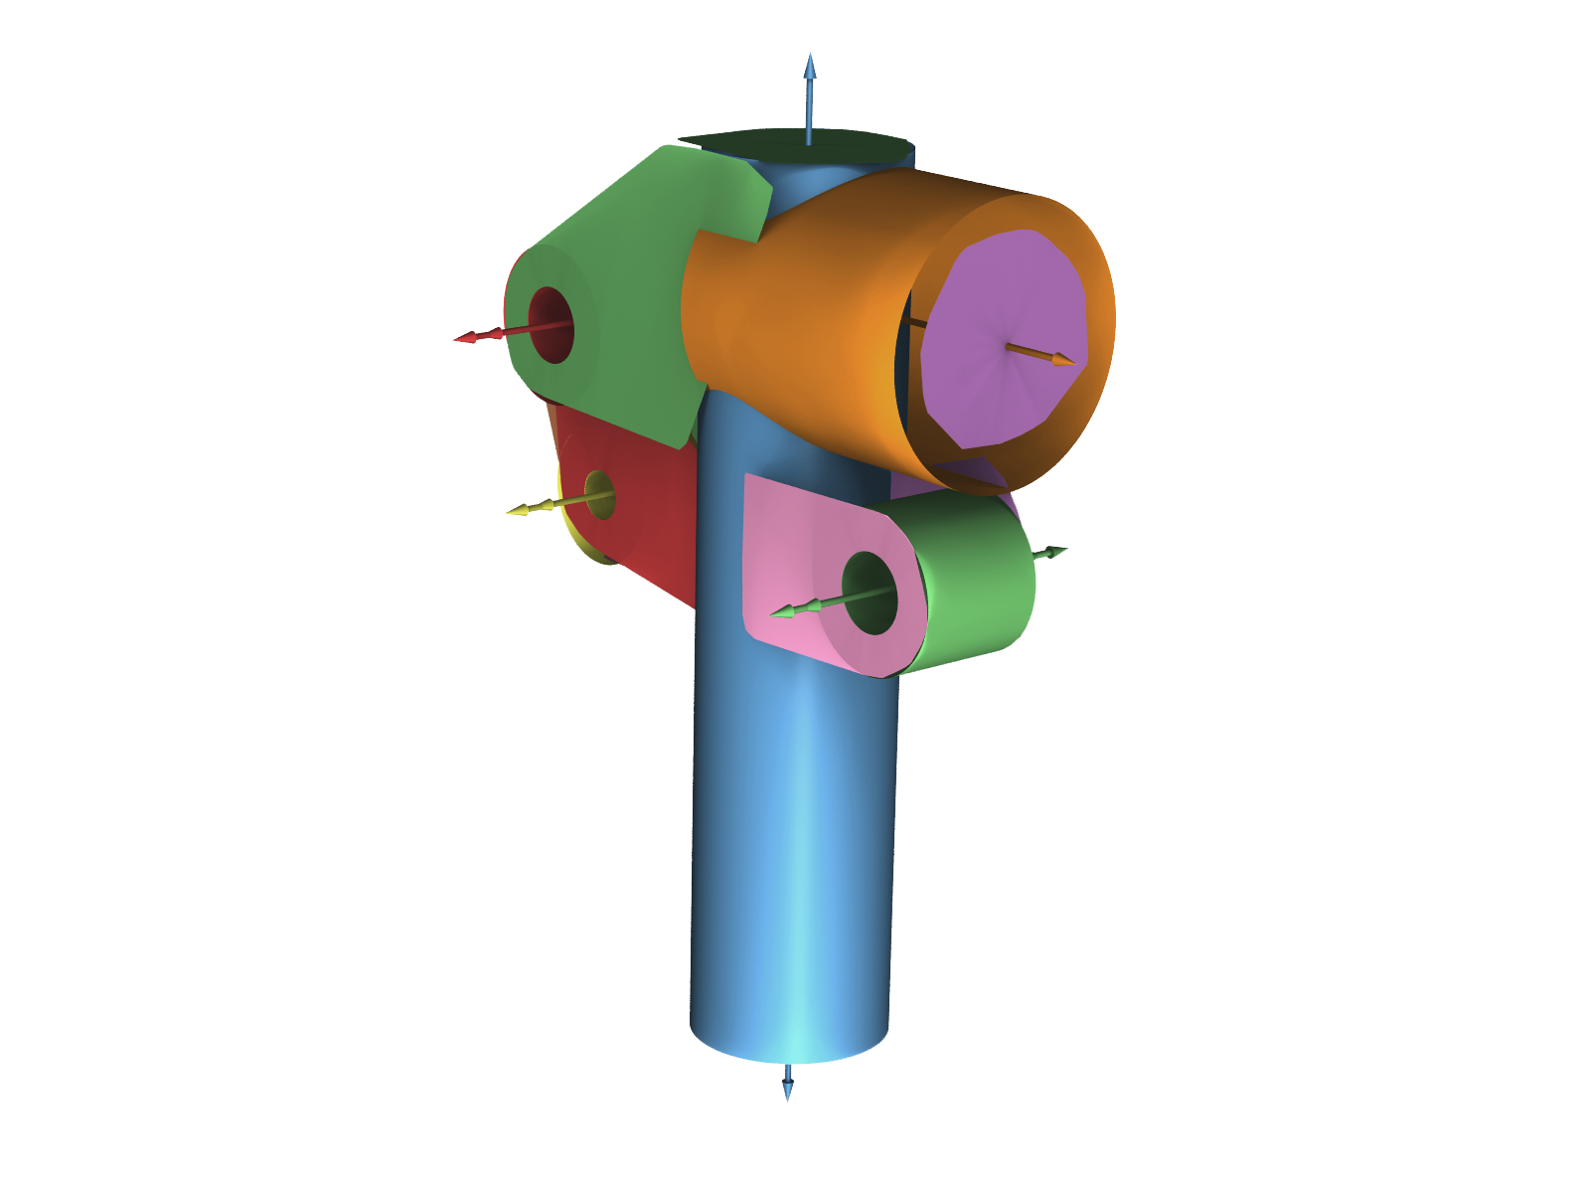
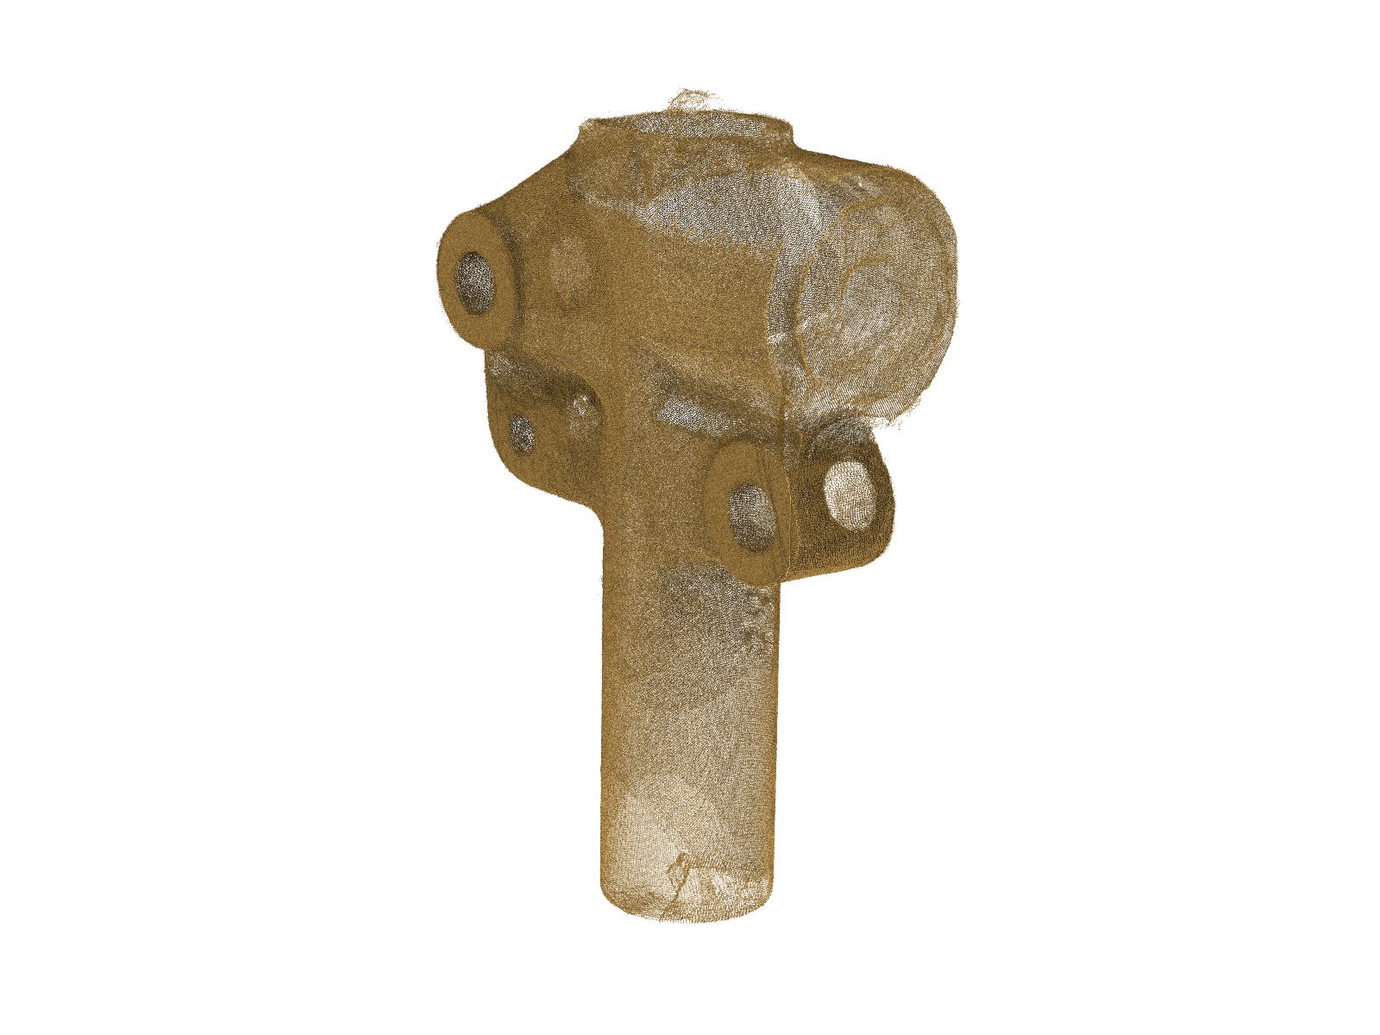
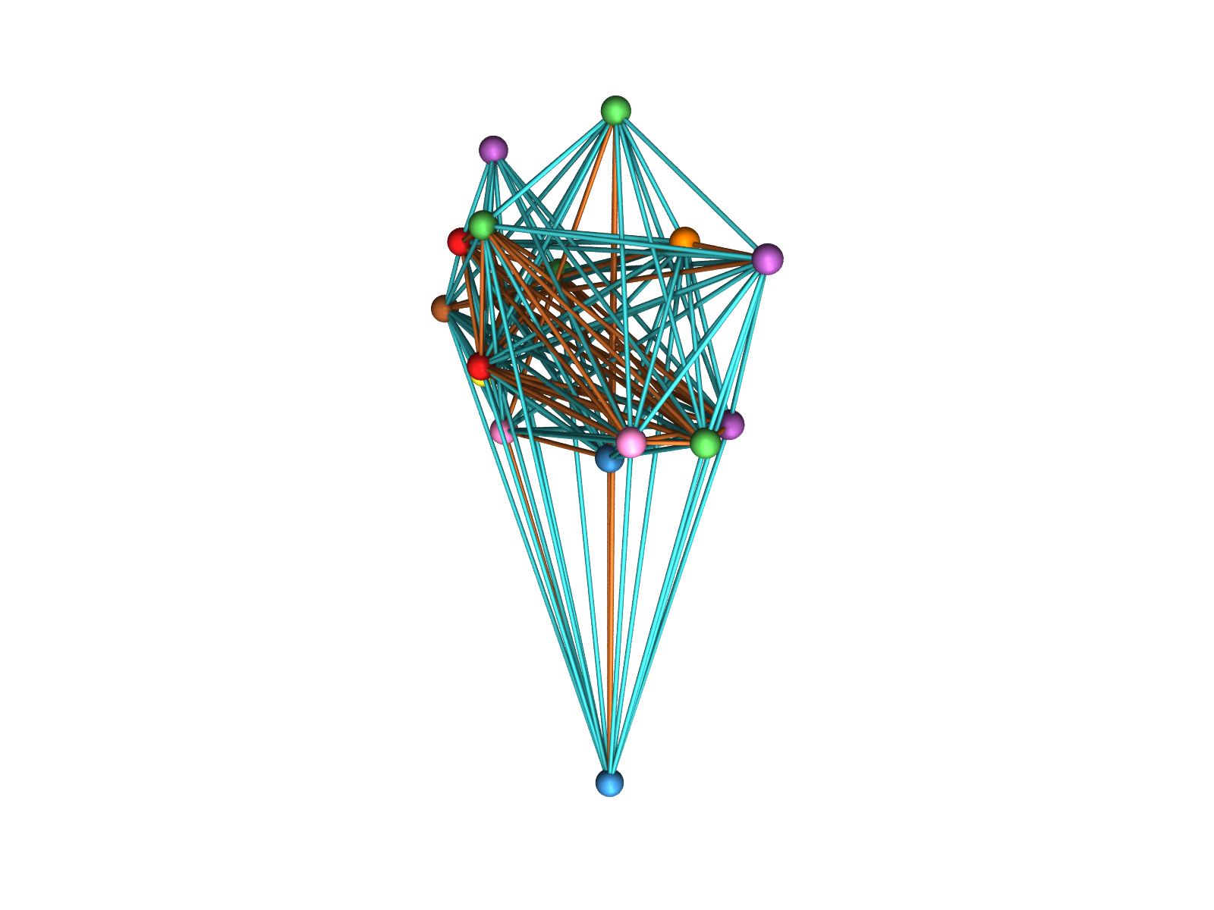
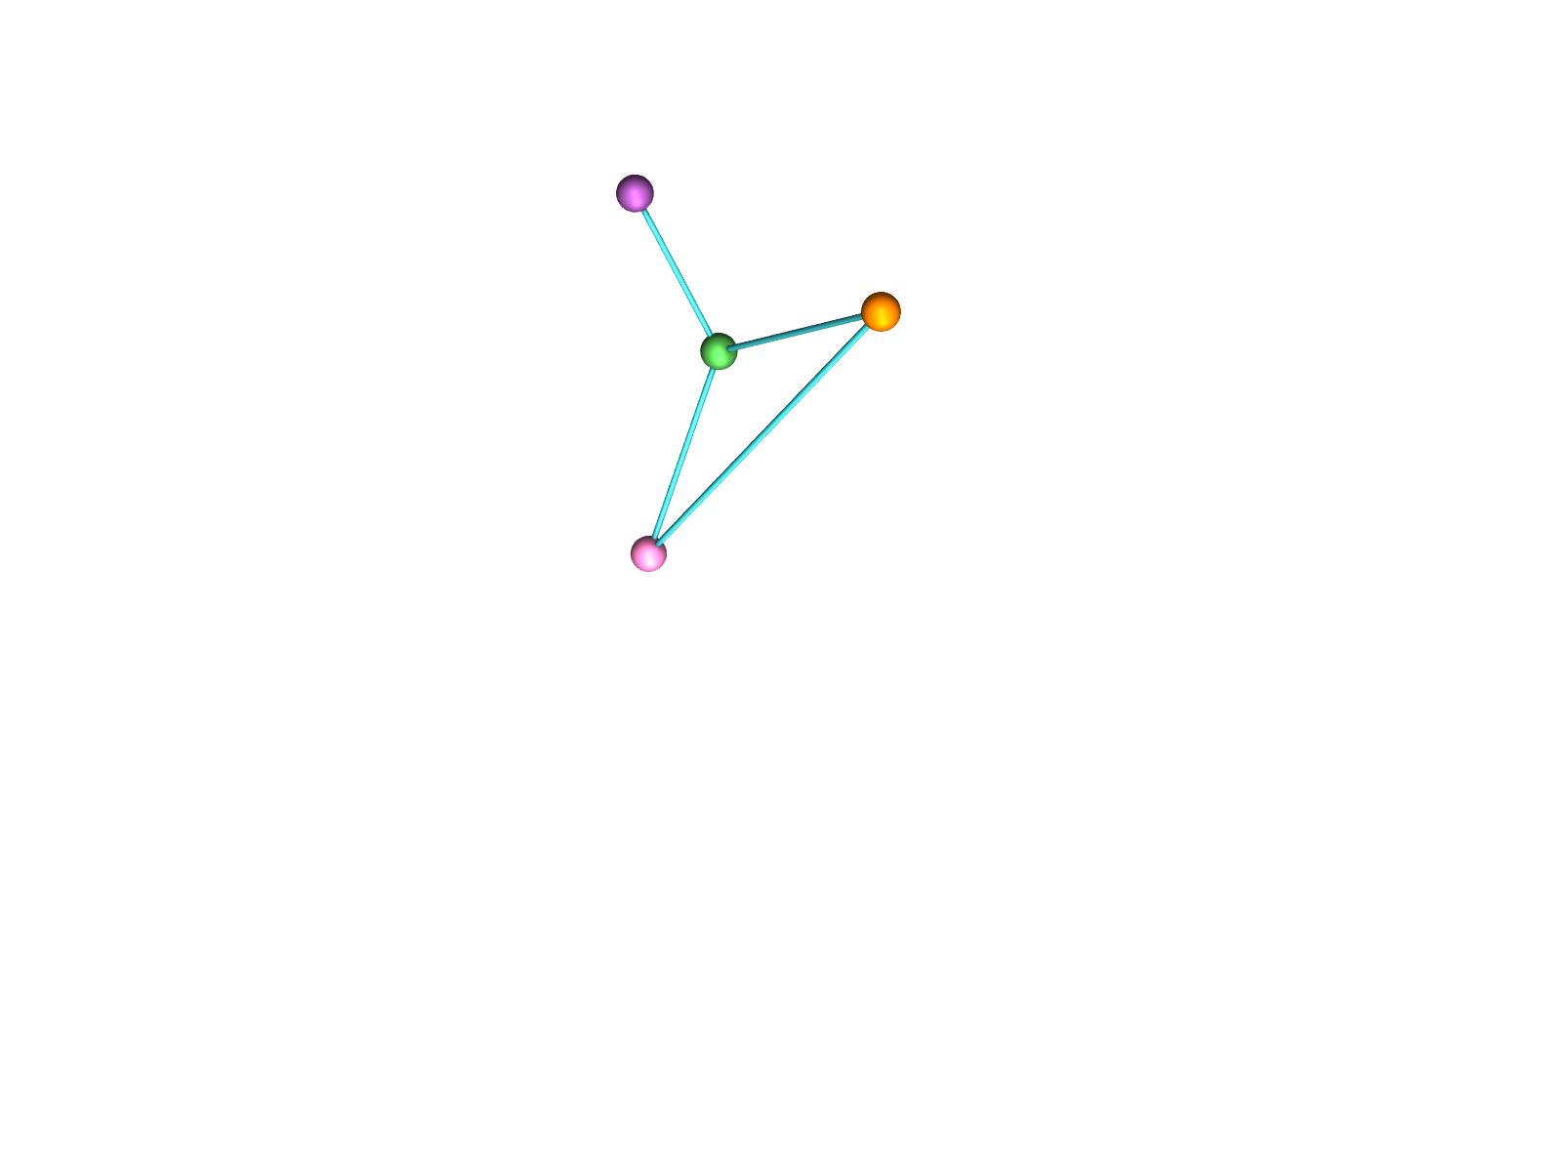

Clutch Model
Equal Radii
Same Orientation
Coaxial
Parallel Axes
Reduced Orientation
Graph
Coaxial
Coplanar
Coaxial
Initial Orientation Graph
Model
Scan
Extracted
Relations
Notes:
Here is a result of a clutch model, which is about as small as your mobile phone, and borrowed from a KAUST garage.
We scanned the model as it is and got the data, which is pretty messy. Then we learn the orientation relations and reduce it.
As you can see here, the reduced orientation graph is much smaller than the initial one.
Finally, various global relations are recovered as well as the global aligned geometry. Note the richness of relations recovered even from such a small object.
However, the cylinder on the upper part is not closed due to missing data, caused by highlight property of the material.

Slide 21






Wheel Part
RANSAC Primitives
Aligned Primitives
Input Model
After RANSAC
After Equal Length
Pairwise Length Histogram
Pairwise Length Histogram
Input Scan
Notes:
Here is another result. The input scan is relatively good, so the misalignments in the initial RANSAC primitives is not obvious from this small picture.
However, if we look at the length histogram, we can clearly see that GlobFit cleans those misalignments caused by scan imperfection and brings primitives to discrete positions with lower complexity.

Slide 22







Packing Foam
Origin Object
Final Model
Reduced Graph
Point Cloud
Initial Graph
RANSAC Primitives
Notes:
Here is a result on your i-Mac packing box.
Starting from a noisy scan, we get the RANSAC primitives, learn the orientation relations, reduce it, and produce the final model.
And the extracted lengths and angles were validated against the physical object.
When the data is poor, we fit more to the relations so the highlighted length here respects to the equal length relations.

Slide 23






Global Relations to Resolve Self-slippage
Input A
Nearly
Orthogonal
Exactly
Orthogonal
Input B
Aligned A
Aligned B
Slippage
Global Aligned
Notes:
We found that global relations can be employed to remove ambiguity arosed in ICP registration.
Input A and B in this example are difficult to align simply using local registration. We first apply GlobFit individually to yield aligned models A and B. Local registration leaves ambiguity due to rotational slippage. We remove this ambiguity using global constraints.
However, bootstrapping is still a problem if the starting scans cover only very small part of the models.

Slide 24


















Limitation
Increasing noise
Input Scan
RANSAC
Primitives
Final Output
Notes:
With increasing noise, eventually GlobFit fails to correct for errors.
It is only natural that wrongly inferred relations will lead to wrong reconstructions.
Please note that there is a balance between data quality and what level of detail that can be reliably recovered.
For certain types of relations, 4 primitives are involved in a single relation. This can potentially lead to O(m4) relations for m primitives, resulting in significant computation times.

Slide 25
Conclusions
Simultaneous primitive fitting + structural relations
Low complexity encoding of man-made objects
Hierarchical relations
One line scene acquisition and understanding
Notes:
We present reconstructions with explicit encoding of detected relations: ready for a system like iWires – intuitive editing

Slide 26
Acknowledgements
Ruwen Schnabel, Pierre Alliez, Cengiz Oztireli, Ran Gal, Suhib Alsisan,Tanveer Alam, Baoquan Chen
KAUST visiting student scholarships, NSFC grants, CAS 100 scholar program, Shenzhen Science and Technology Foundation, CAS Visiting Professorship for Senior/Young Int’l Scientists, Cyprus RPF Grant Diethnis/Stochos/0609, Israel Science Foundation, European FP7 276982
Notes:
And finally, many thanks to people who provided code, comments, helped with initial experiments, and proof read the paper.
Also thanks to our many funding agencies.

Slide 27




thank you
Initial Orientation Graph
Reduced
Orientation Graph
Finally Aligned Primitives
Input Object
code and data freely available for research
Notes:
We have code and data freely available for research.
That’s all! Thank you all for coming to this talk!

Slide 29

Performance
model | point # | primitive # | parallel/ortho. | eq. angle | Placement | eq. length | eq. radii | time(in sec)
wheel | 283K | 39 | 741$→$0(38) | N/A | 359$→$75 | N/A | 66$→$18 | 227.3
foam | 382K | 56 | 544$→$14(58) | 128$→$37 | 25$→$18 | 68$→$20 | N/A | 875.6
clutch | 841K | 21 | 205$→$8(25) | 26$→$17 | 27$→$18 | 8$→$3 | 4$→$3 | 573.1
pipe | 529K | 43 | 696$→$7(44) | 40$→$21 | 90$→$43 | 222$→$19 | 88$→$27 | 838.5
boxy | 100K | 26 | 121$→$13(28) | 250$→$44 | 11$→$9 | 20$→$8 | 7$→$4 | 319.3

Slide 30





Towards Better Reconstructions
[ICCV 2011 (to appear)]

